Slide 1
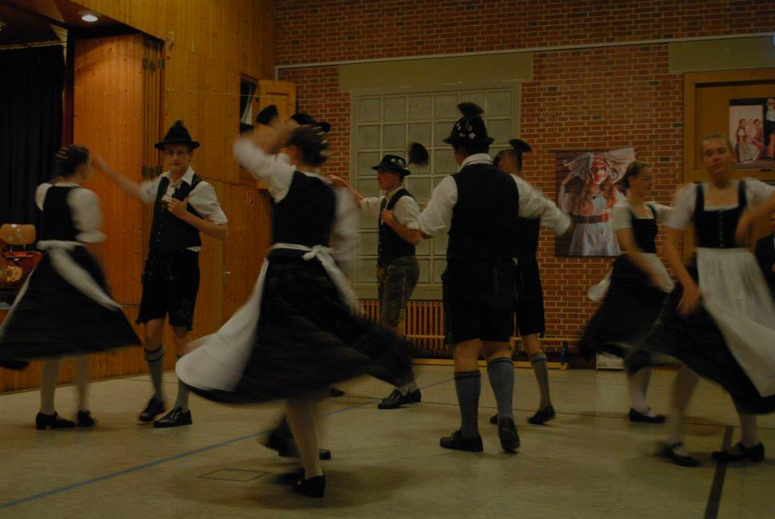
Comenius meeting:
Germany!

Slide 2
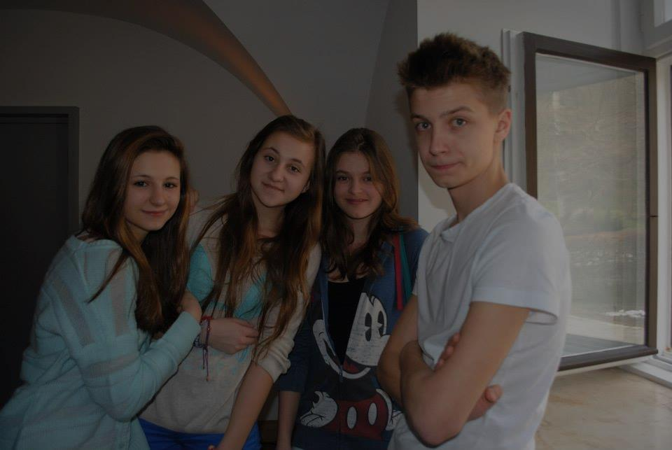
Our task was to present
four fairy tales

Slide 3
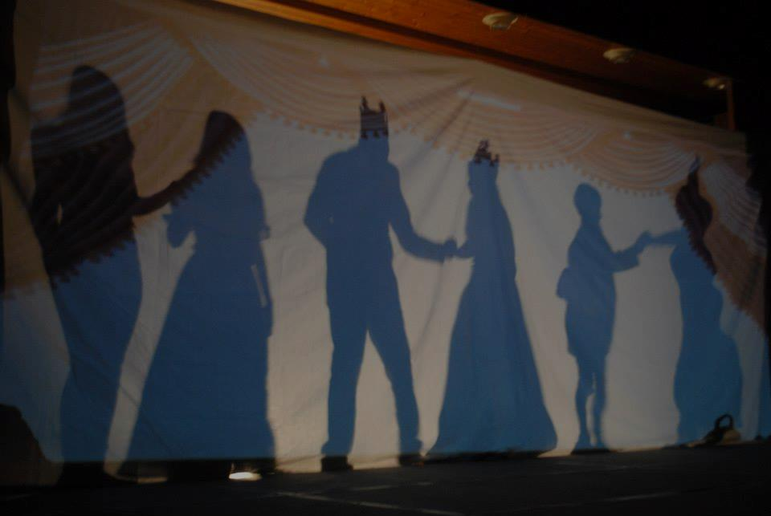
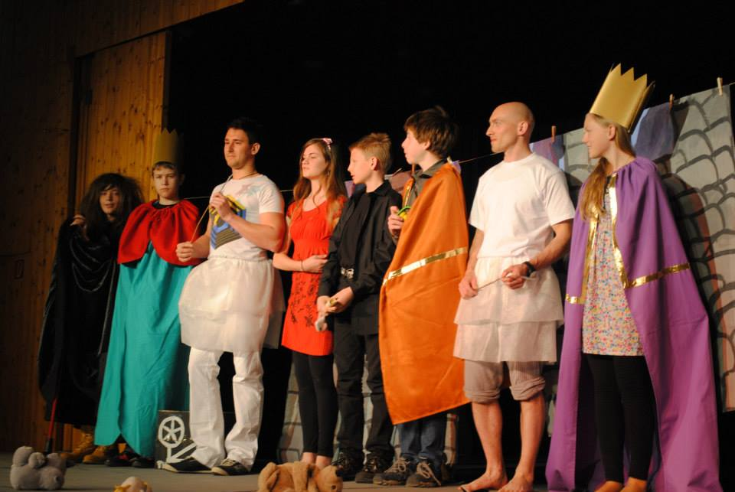
Hungary and Slovenia: Sleeping Beauty

Slide 4
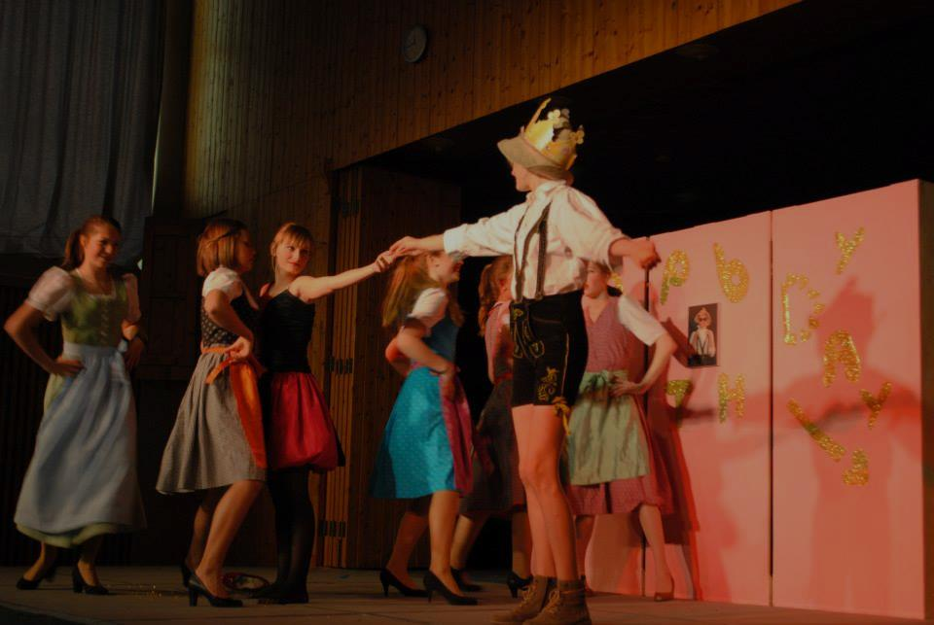
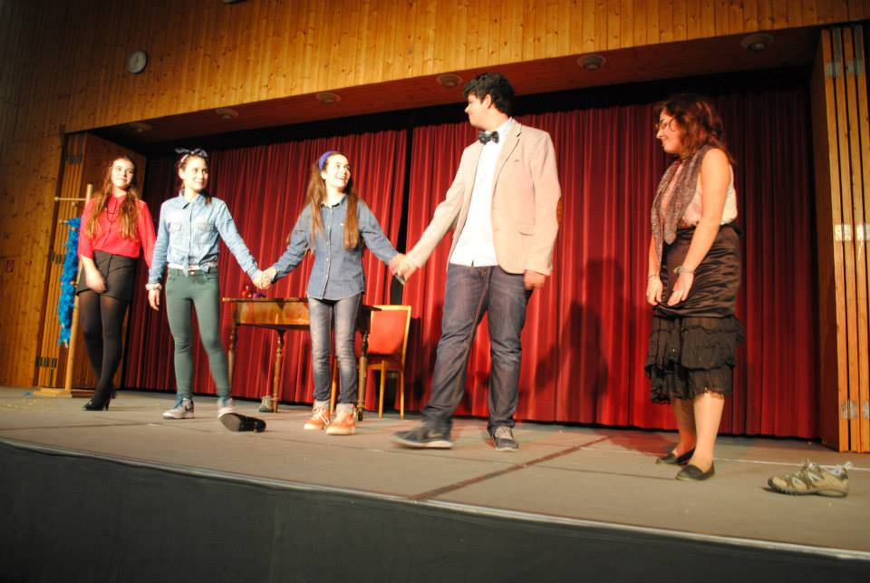
Germany and Portugal:
The Cinderella

Slide 5
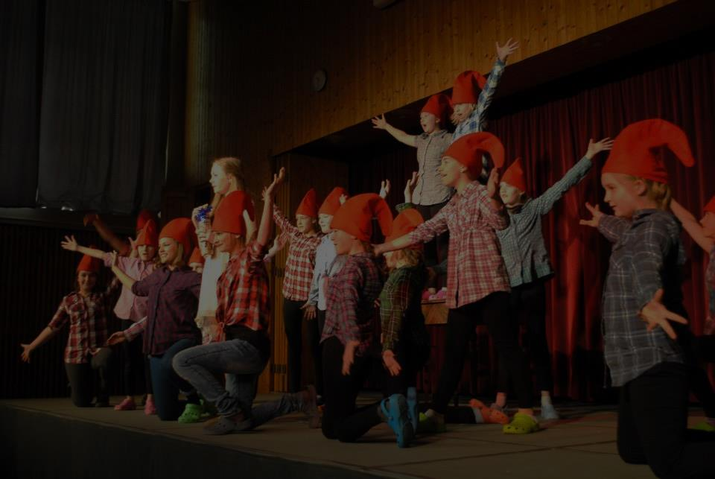
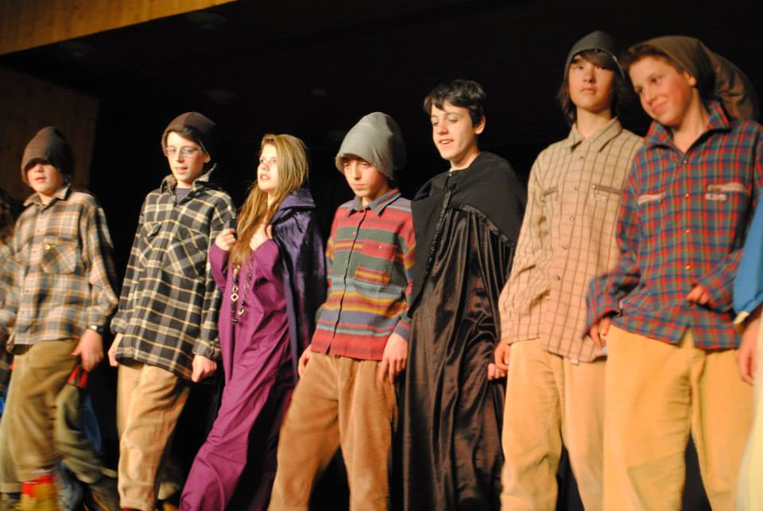
Germany and Italy Snow White and the Seven Dwarfs

Slide 6
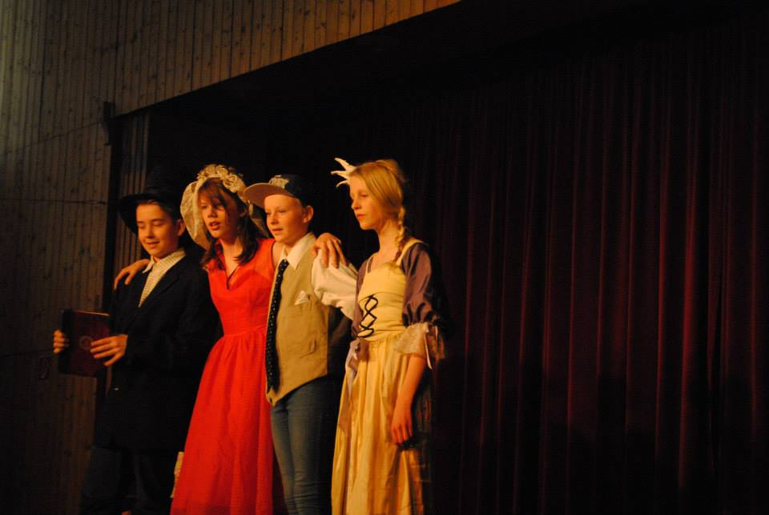
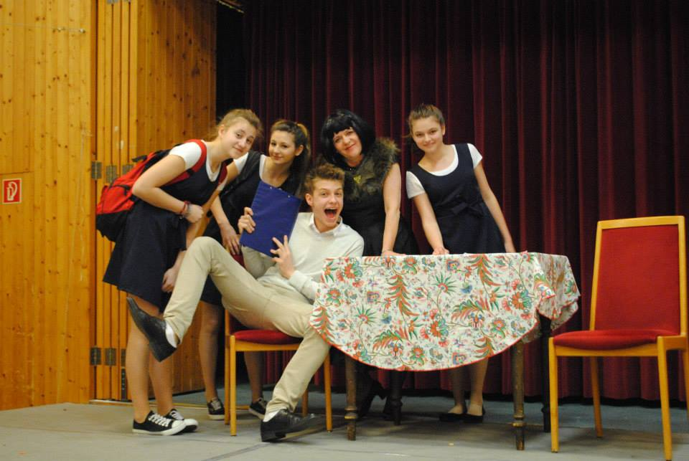
Poland and Denmark The Princess on the Pea

Slide 7
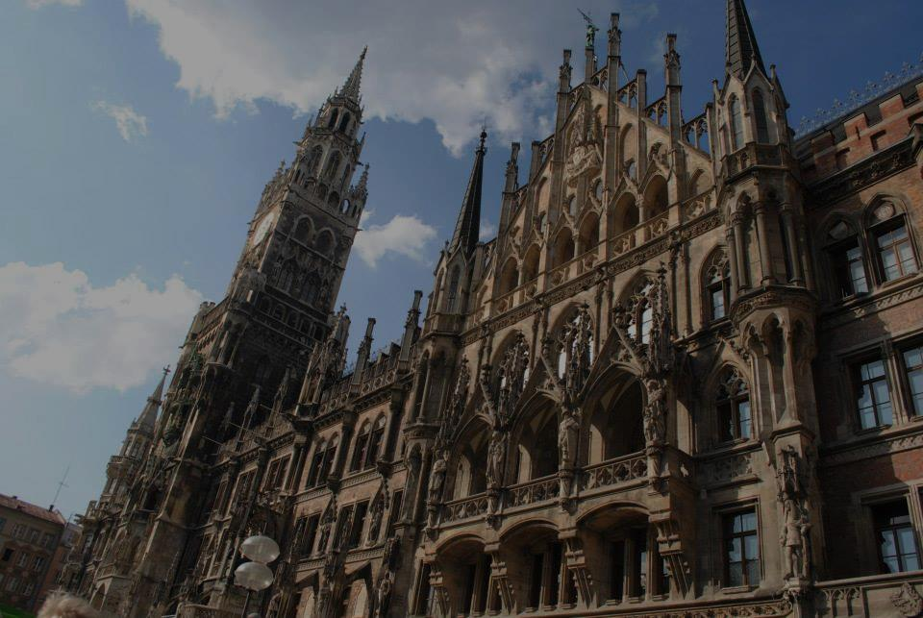
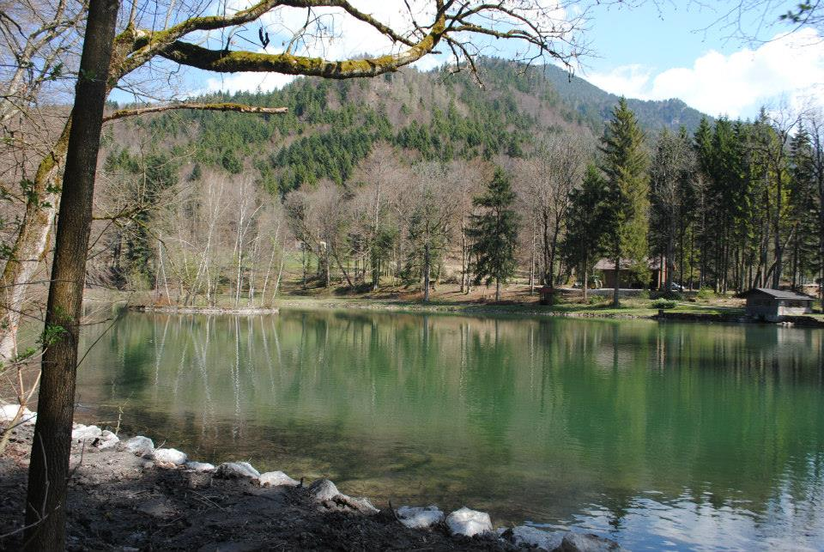
After all shows we had a lot of
entertainment and sightseeing.

Slide 8
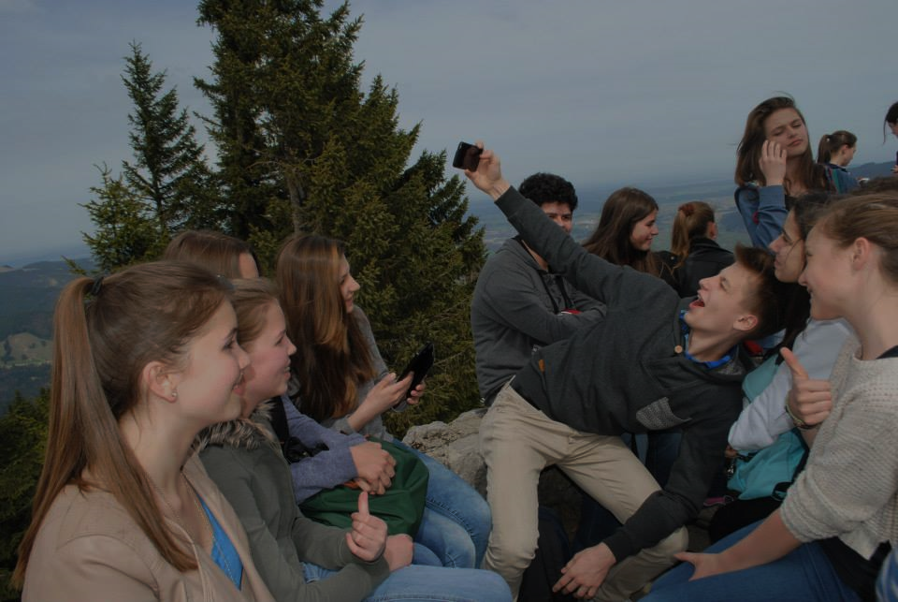
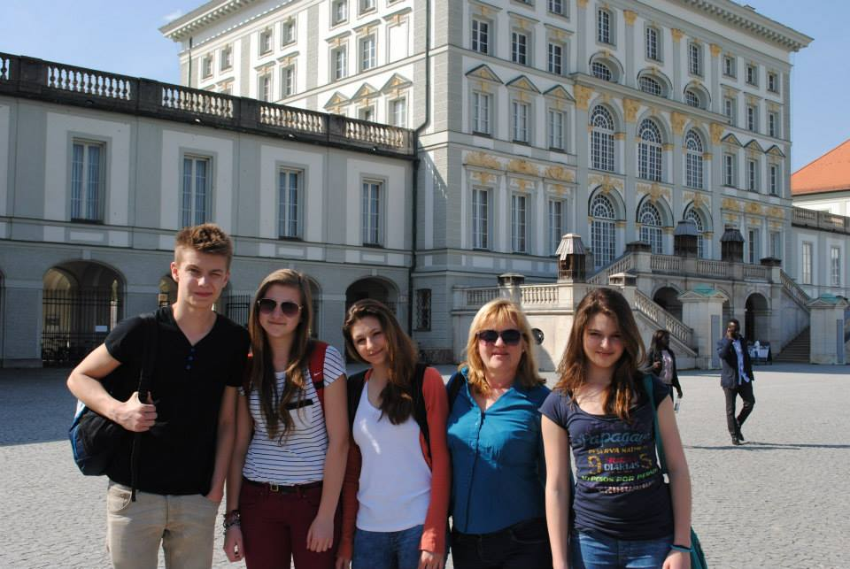
Mountains and photos:

Slide 9
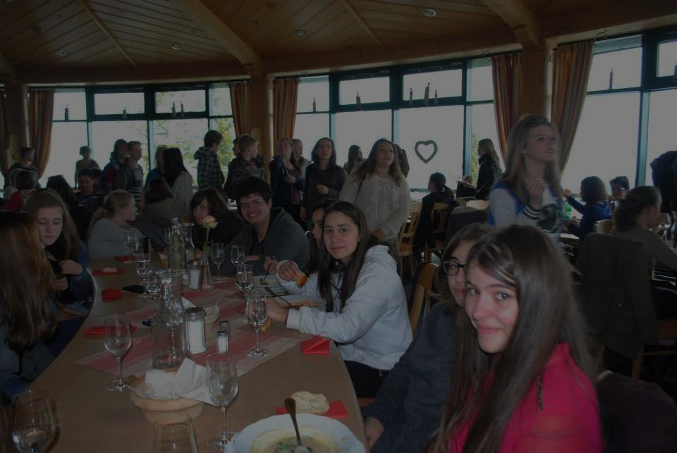
Eating and talking:

Slide 10
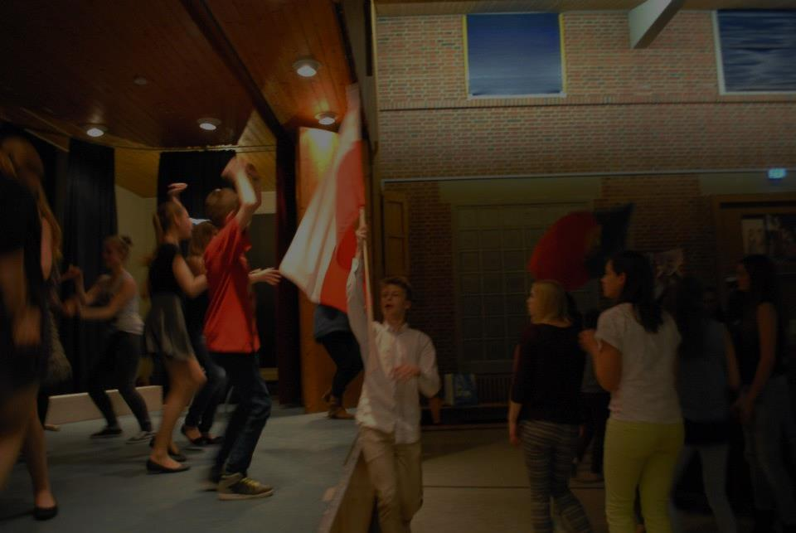
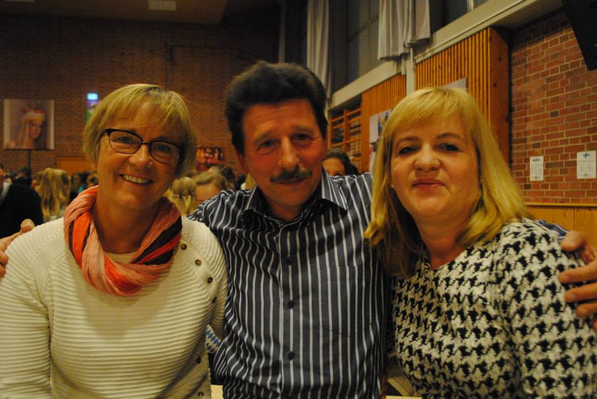
The last day we had a farewall
dinner at the real Bavarian-Style:

Slide 11
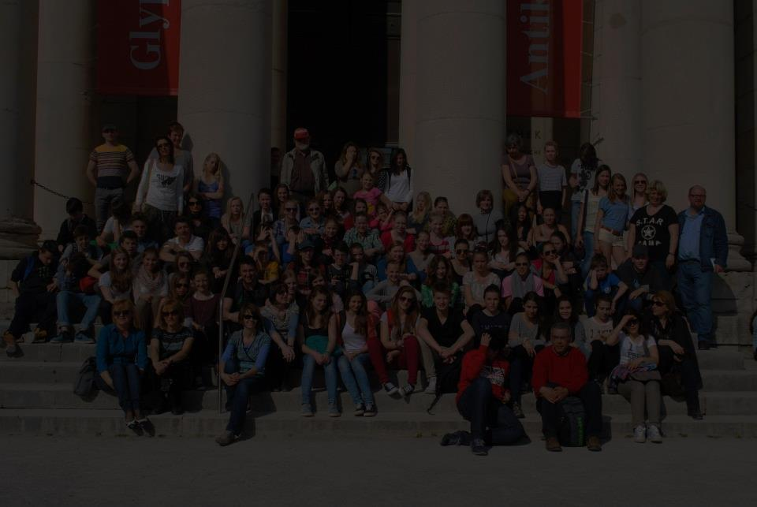
Dear Germany: Thank you for everything.
Meeting in your
country was amazing.
Thanks for the
hospitality and
nice time with your students. We miss you so much! ☺

