Slide 1
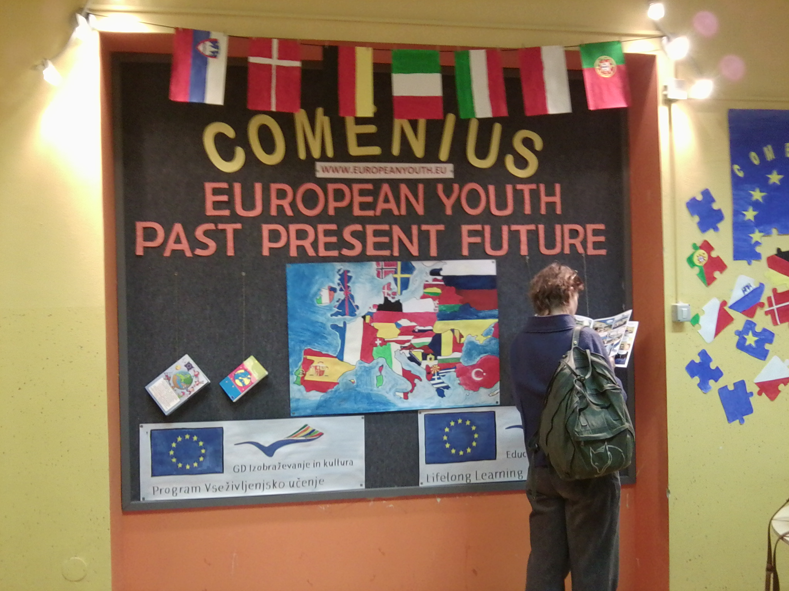
Comenius Meeting in Slovenia
German diary

Slide 2
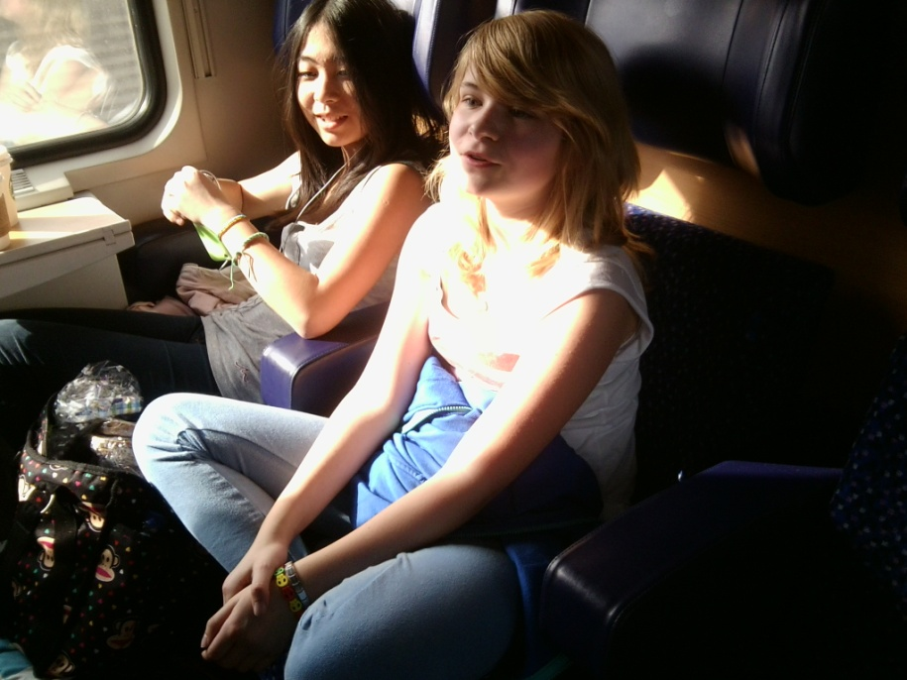
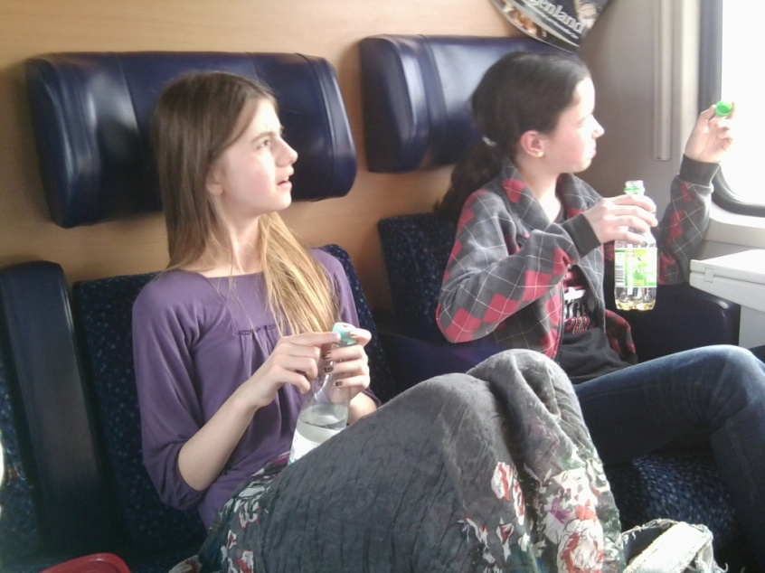
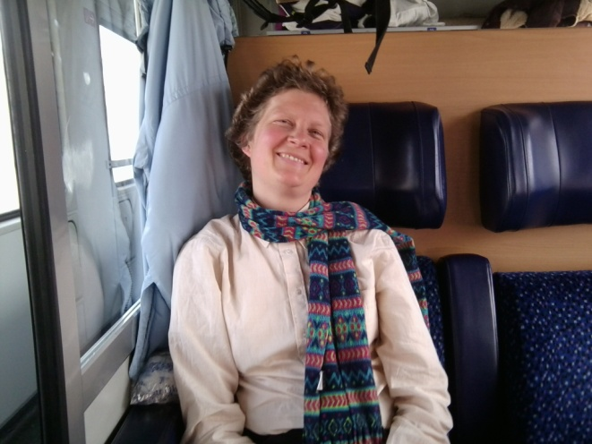
Monday, 11th March 2013
We are setting out to Kropa in Slovenia by train, travelling from Lenggries via Munich, Salzburg, Villach to Lisce/Bled. We, that means two seventh graders, Tatjana and Patricia, two eighth graders, Gloria and Elena, as well as the teachers Tamara Höcherl and me, Christine Hoyer.

Slide 3
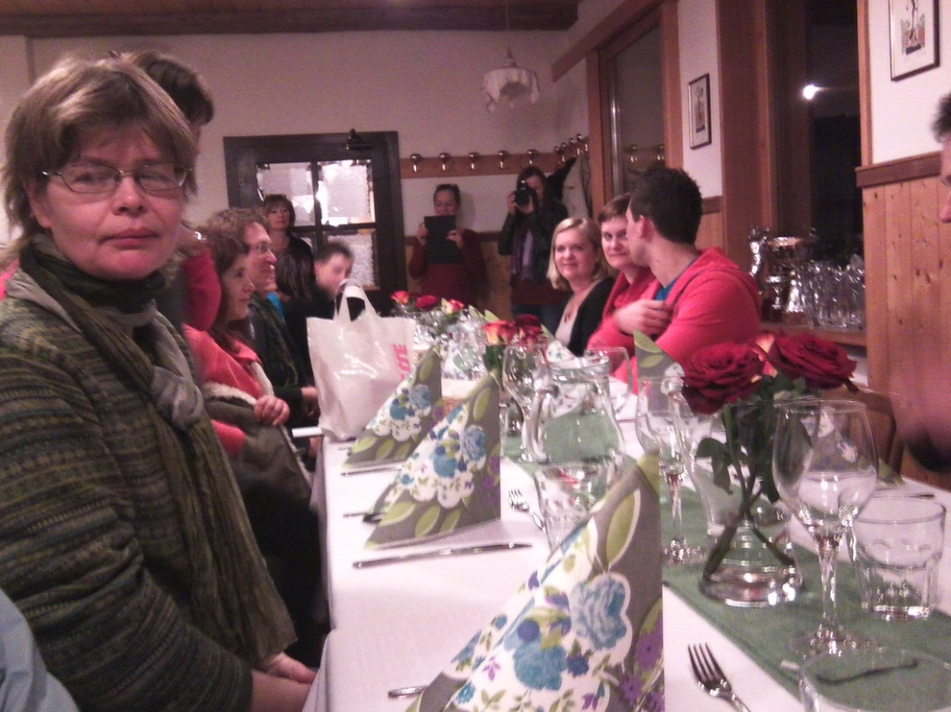
Monday, 11th March 2013
After having arrived at the school “Osnovna šola Staneta Žagarja Lipnica “ Andrej Kavcic welcomes us in Slovenia and the girls are picked up by their guest families, an exciting moment for them. The teachers are brought to their accommodation in a guesthouse ten minutes by car, where we meet our headmaster, Mr. Beck. Nearly about 9 o´clock p.m. All teachers have already arrived and the welcome-dinner can start.

Slide 4
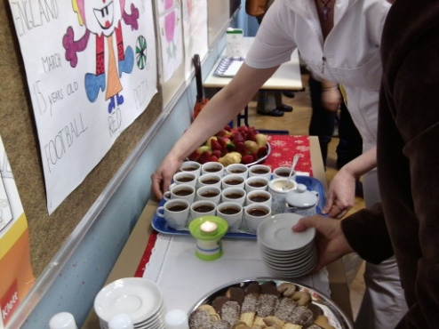
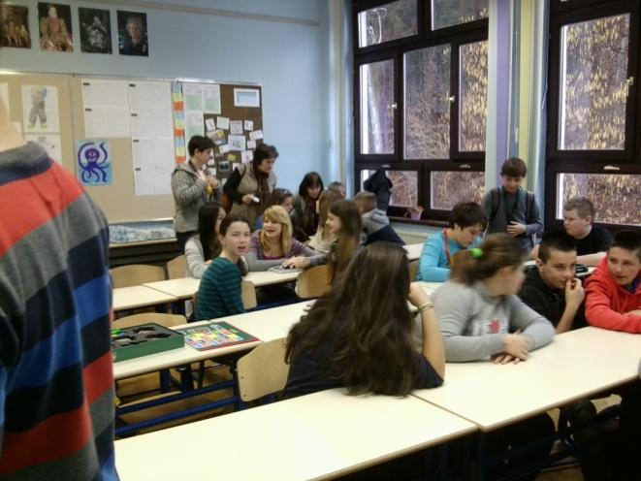
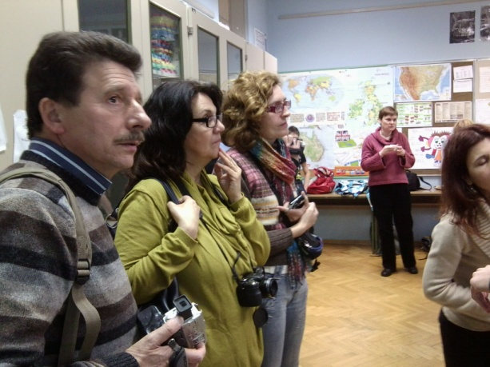
Tuesday, 12th March 2013
Early in the morning we start our visit of the school in Lipnica with a delicious Slovenian coffee: hot water, coffee powder and sugar, a very tasty moment. Afterwards we take part in some lessons with different subjects. For me and Tamara Höcherl, as math-teachers it´s funny to hear about squares and rectangles in the Slovenian language. A few minutes are enough to understand the whole lesson in a foreign language - so easy is mathematics!
Our students´ first choice is “physical education” with the first graders, put simply - crawling under benches and boxes. They feel like “giants”. Also a lot of fun is the German lesson, so they see how the Slovenian students try to learn German and come to know the difficulties of our language.

Slide 5
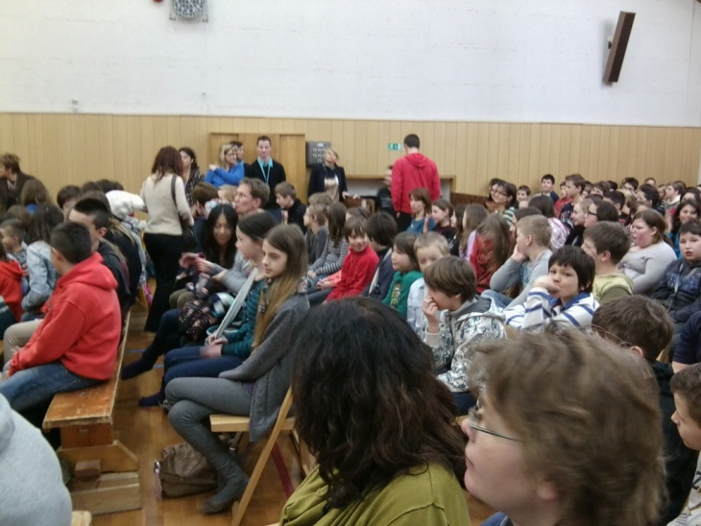
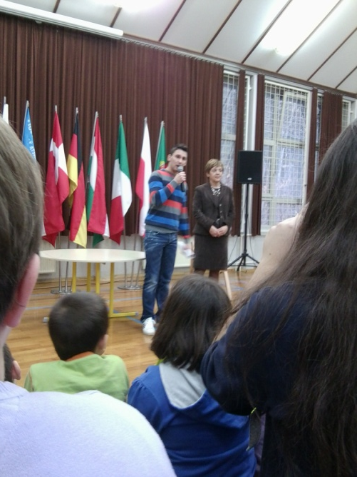
Tuesday, 12th March 2013
Now the official welcome begins. Andrej Kavcic and the headmistress Alenka Cuder find some warm-hearted words for all the Comenius-Partners, the teachers and students, so everybody could feel the kindness of the Slovenian people.
The European and the Slovenian hymn presented by a boy with his accordion make it a moving moment.
The introduction of the partners starts with Germany with Mr Beck describing where we are from and what´s interesting about our school. I think, especially the boys will remember Hohenburg is close to FC Bayern München.

Slide 6
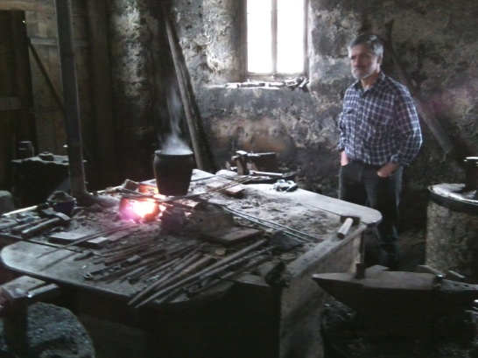
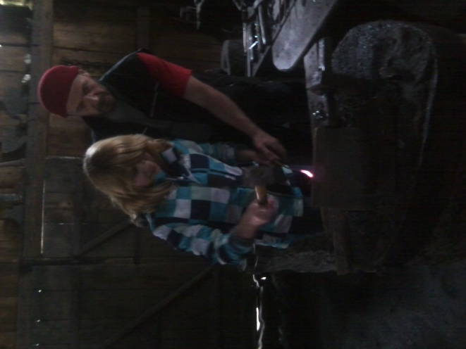
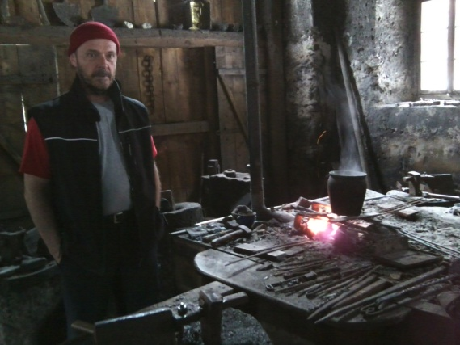
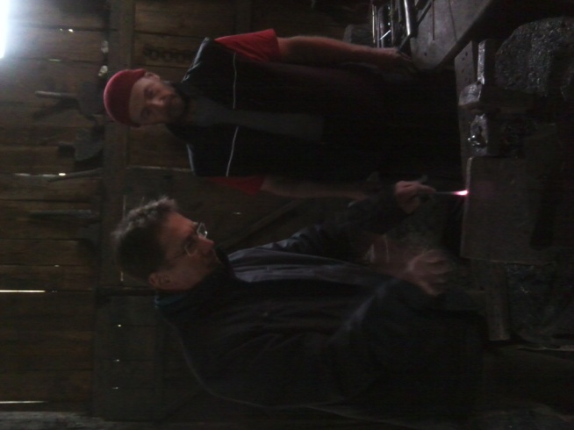
Tuesday, 12th March 2013
In the afternoon we take a walk to the village Kropa to visit the blacksmith-museum and an old blacksmith-workshop. In the museum we learn a lot about the ancient life in Kropa, when children had to work with their whole family at the blacksmith´s to produce iron nails. Men produced big nails, women and children shoe-nails. By selling the nails Kropa became a very rich village, but for most people life was rather poor and hard.
To find out, how hard working life was in those days, some of us were asked to manufacture small nails that they could keep.

Slide 7
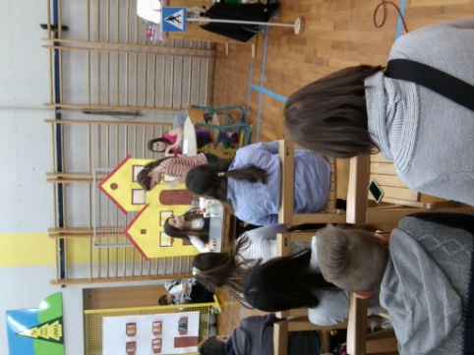
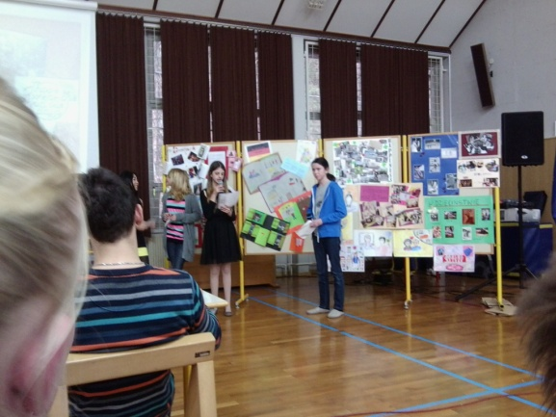
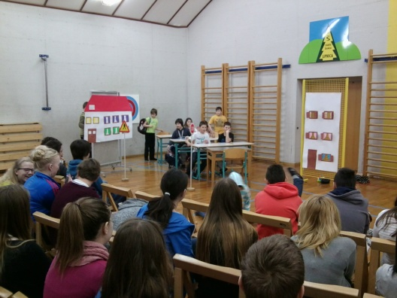
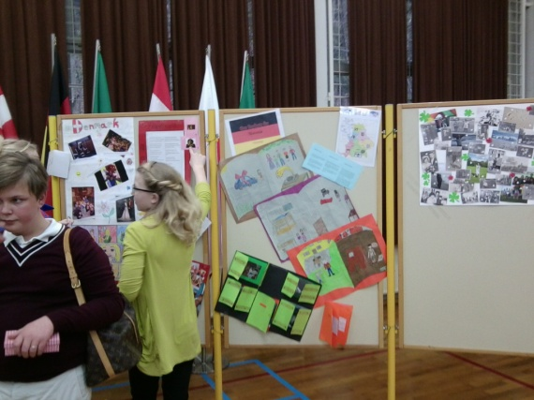
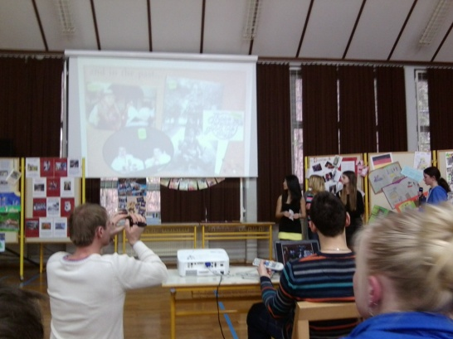
Wednesday, 13th March 2013
Today is the great exhibition with all sorts of products
and a game we produced a few weeks back. But before starting
the presentation, the fourth graders of Lipnica valley perfomr a stage play.
After lunch the gym is prepared for the great exhibition
and the students present their products.

Slide 8
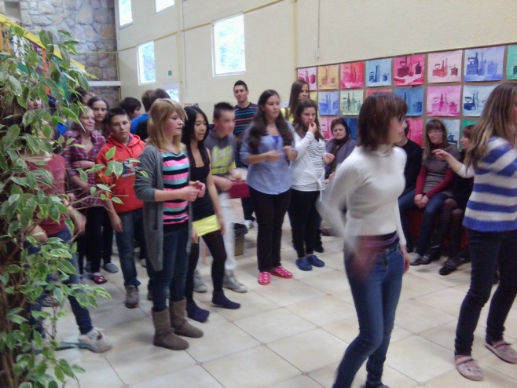
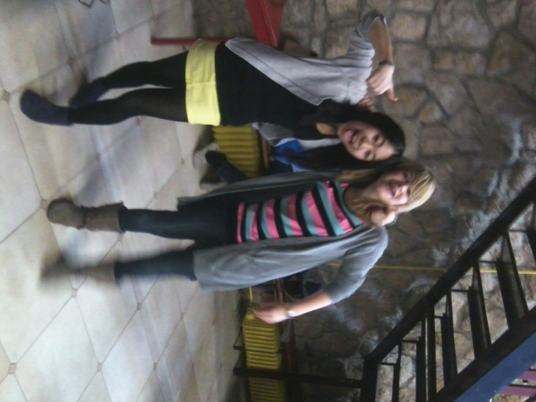
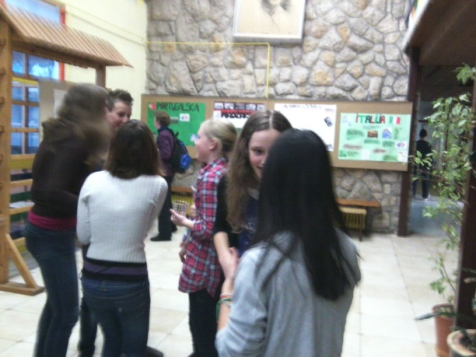
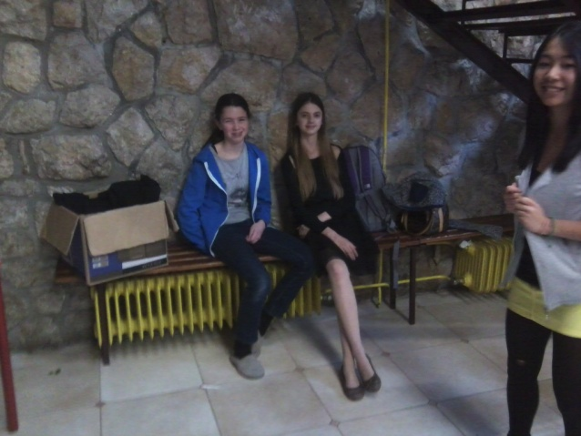
Wednesday, 13th March 2013
The successful exhibition is the reason for having a party with traditional dances, our famous flash mob and disco dancing. The careful arranged snack – as always a real
treat for us .

Slide 9
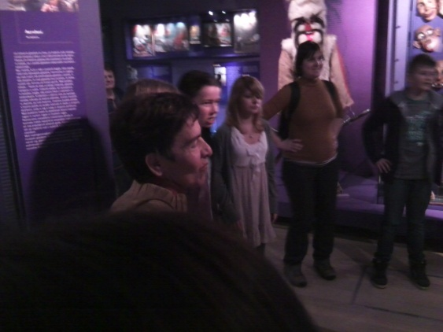
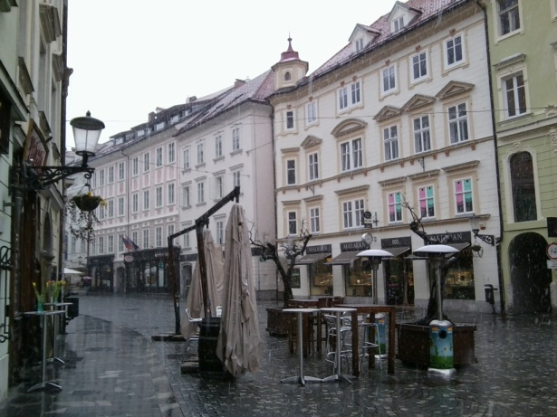
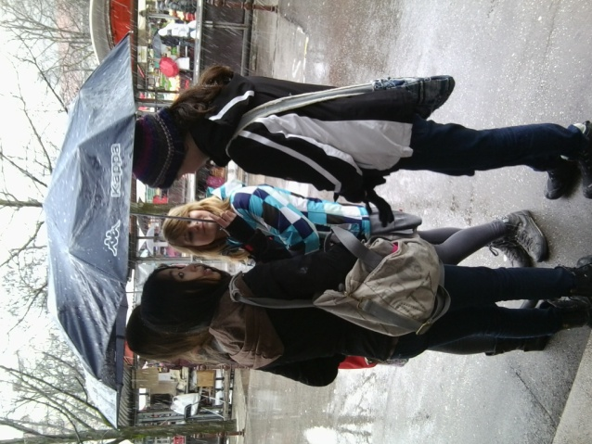
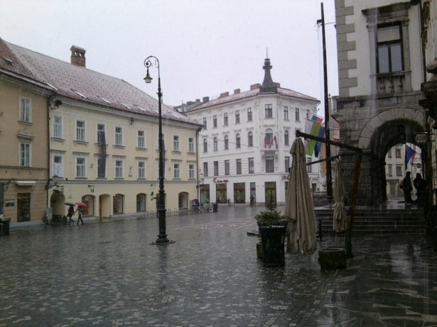
Thursday, 13th March 2013
The country´s capital is our destination. We go there by bus in spite
of rain with snow and low temperatures. First stop is the ethnographic
museum and we learn a lot about life an the Slovenian region.
Fishing, hunting and agriculture as well as traditional life are presented at the exhibition.
Ljubljana is now discovered on foot and Andrej tells us some interesting facts about the capital city of Slovenia. After a two hours free time we are all happy that Andrej decided to take no walk to the castle, but to go back to the warm bus.

Slide 10
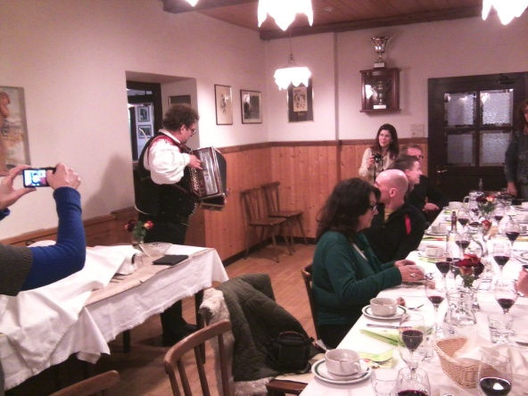
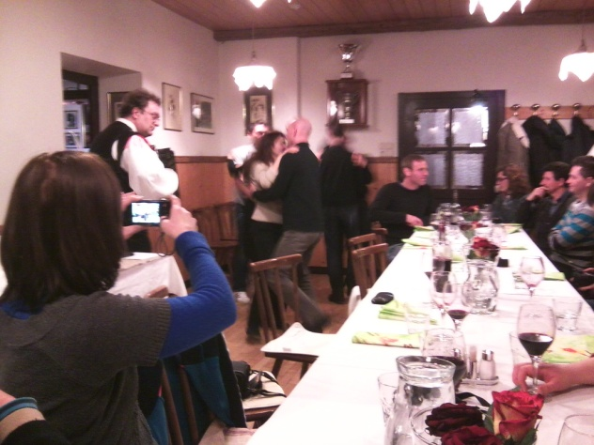
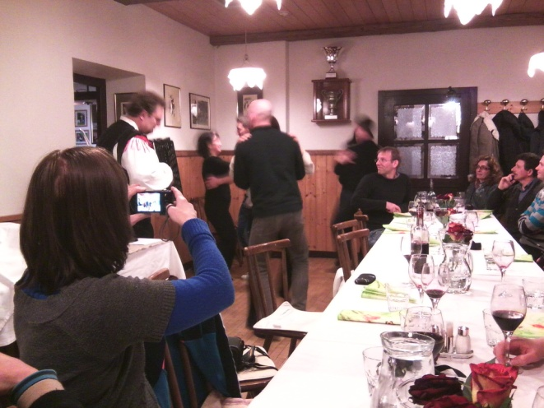
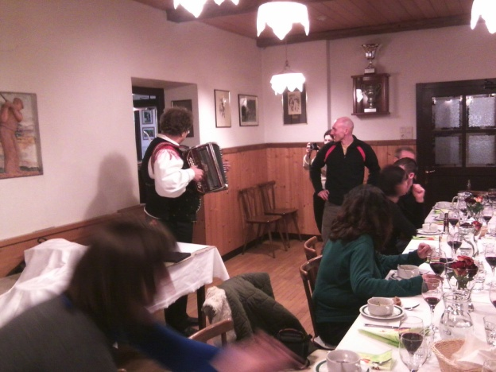
Thursday, 13th March 2013
In the evening dinner is joined by a very funny accordion player. Dancing and singing makes the time pass by and the farewell is approaching. It was high time to meet friendly people from all over Europe. Thank you for this experience.

Slide 11
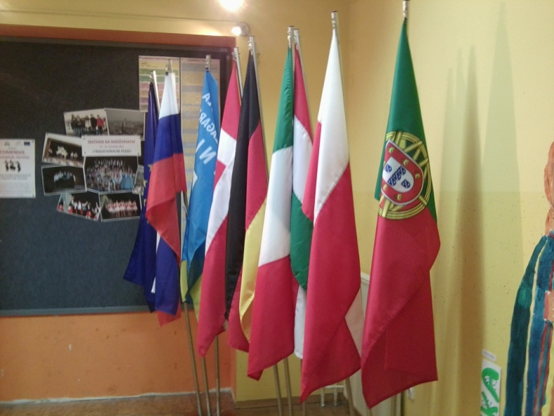
Friday, 13th March 2013
We travel back to Germany by train. It keeps 7 hours again, through the Austrian alps with snowy mountains and sunshine.
The meeting in Slovenia will be in our minds for a long time. The impressions of an other country, foreign people and especially the kindness of the Slovenian teachers, students and families are gifts, we bring back to our school.

