Slide 1

Comenius meeting in
Portugal
May 5th-9th 2014

Slide 2
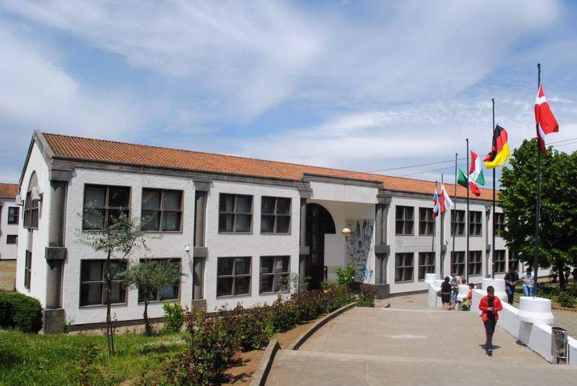
„Agrupamento de Escolas Miguel Torga”

Slide 3
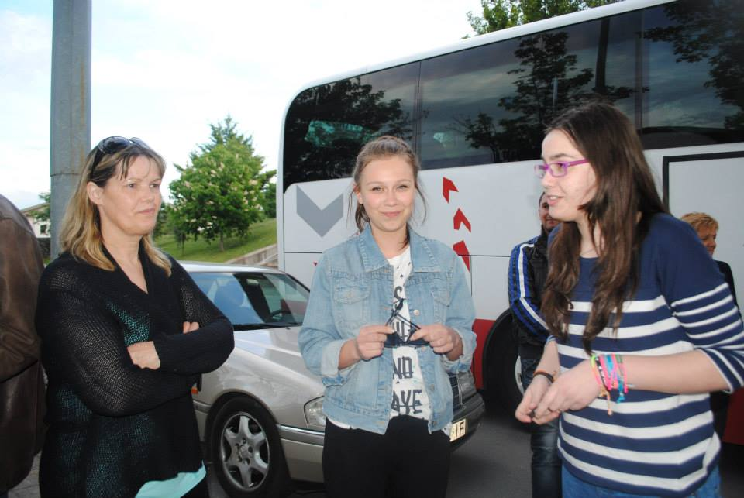
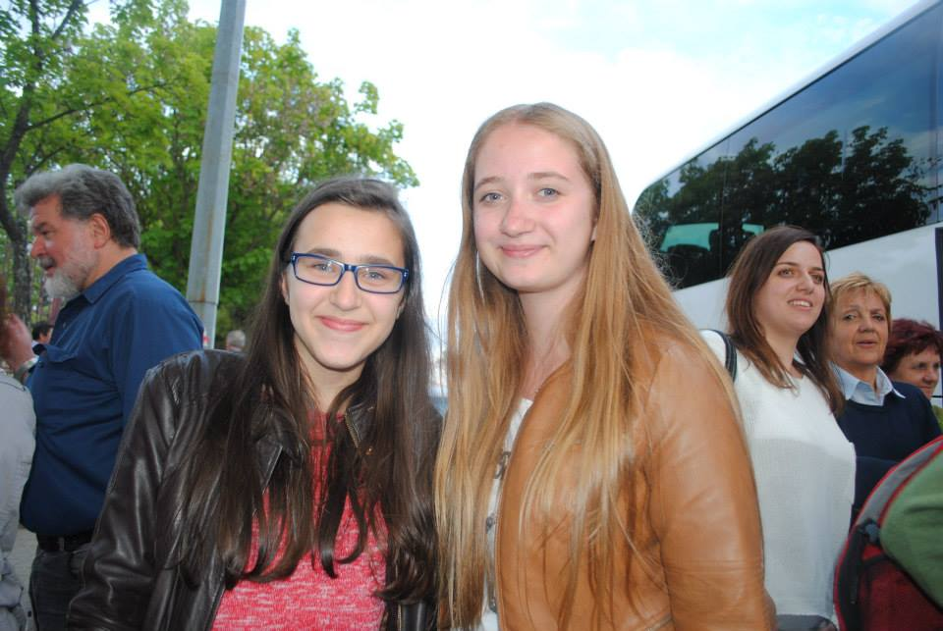
May 5th
1st Day
On May 5th we arrived at Braganca and were finally able to see our friends and hosting families.

Slide 4
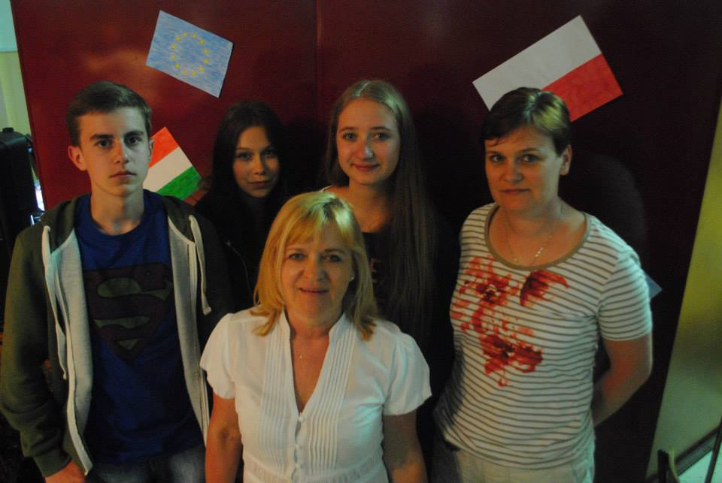
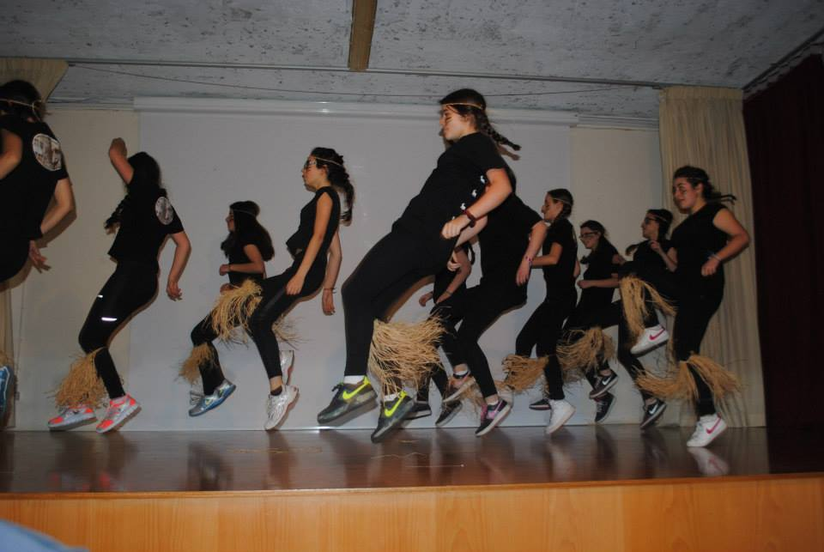
May 6th
2nd Day
On Tuesday we spent 1st day in school. Portugese teachers & students prepared a great welcoming ceremony. They were dancing, singing and also gave us an opportunity to present ourselves – to say something about our city and school.

Slide 5
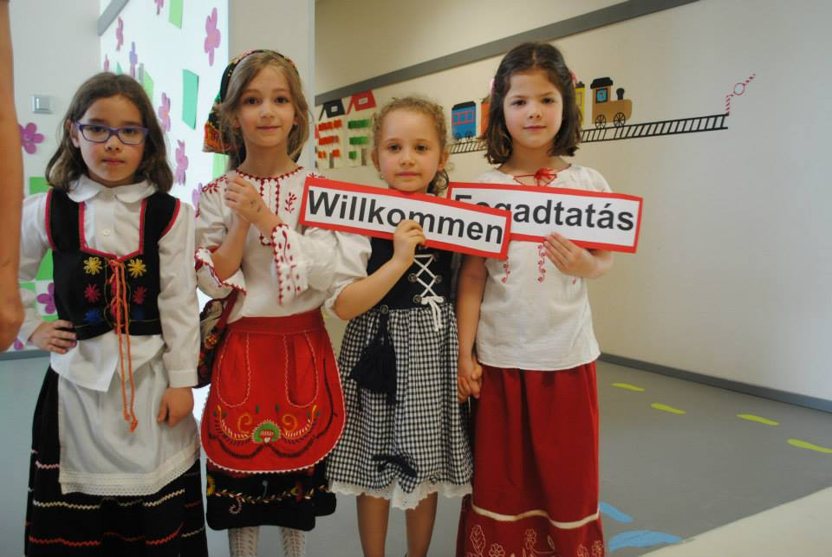
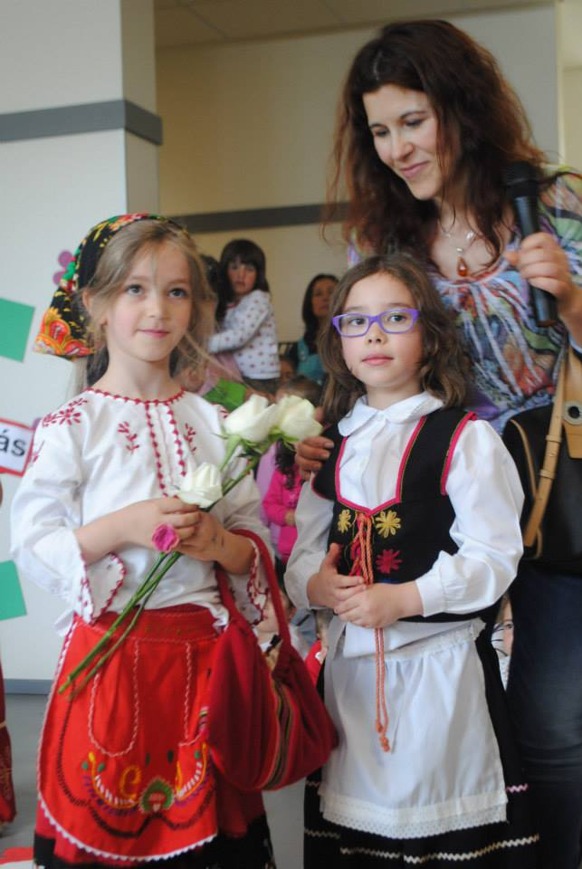
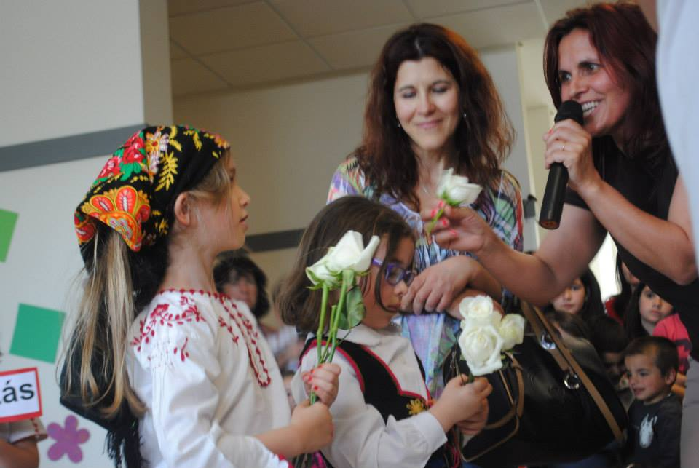
The youngest students from Portugal’s school.

Slide 6
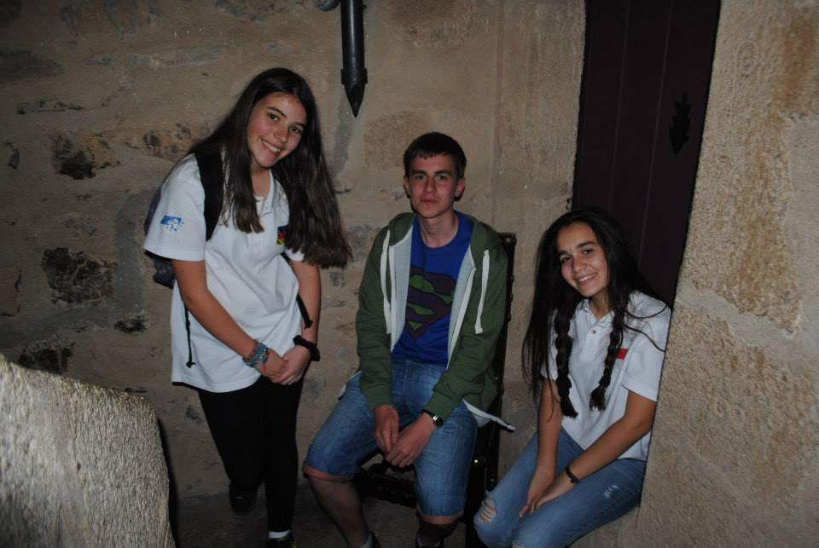
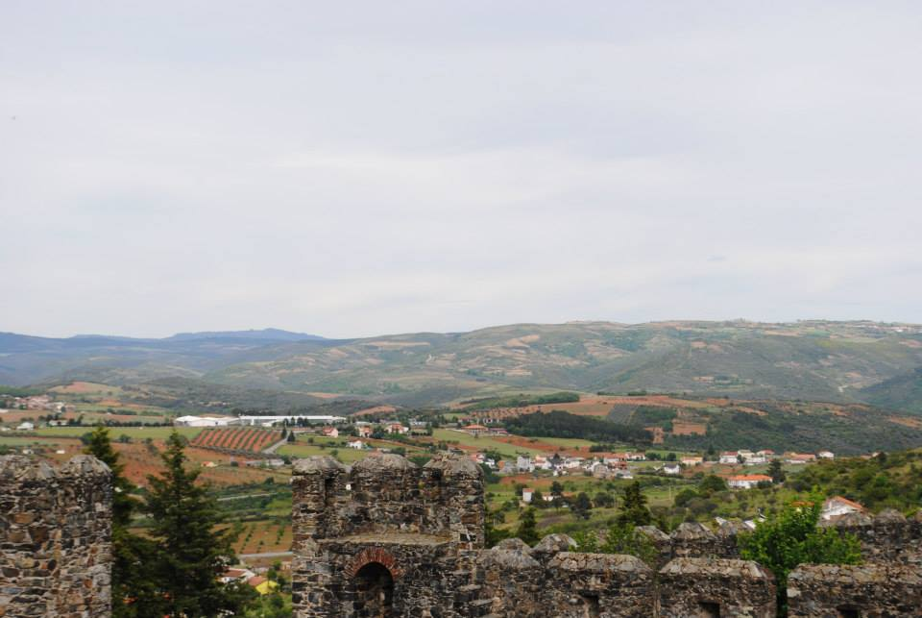
Trip to Old Castle and Military Museum
in Braganca.

Slide 7
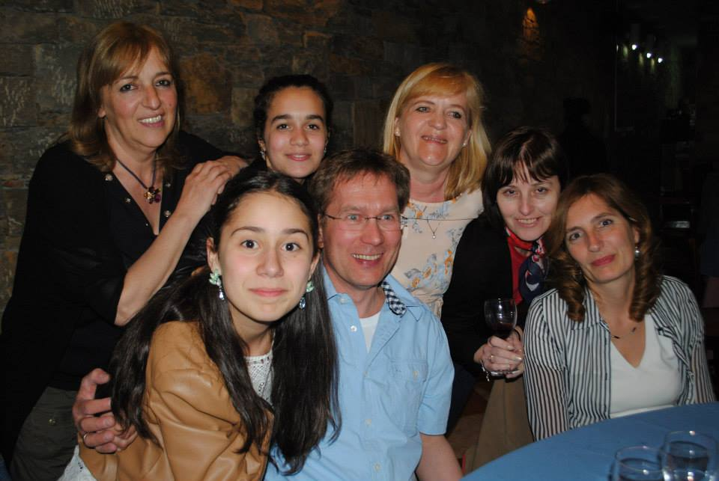
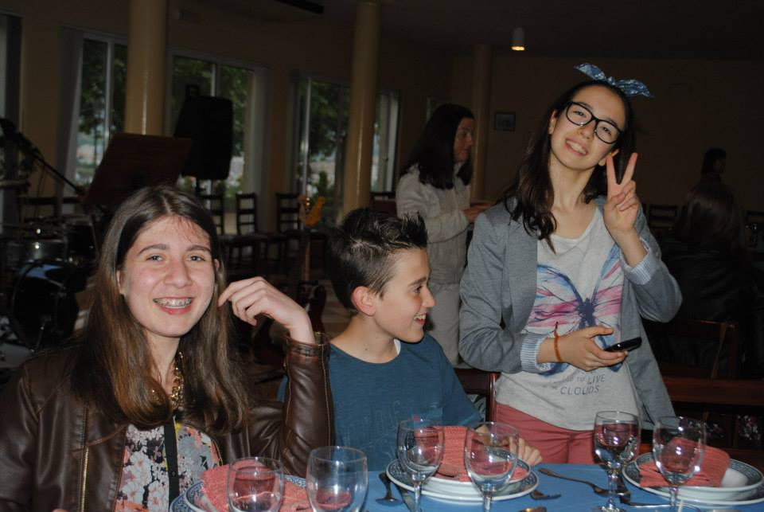
On Tuesday we also had a great dinner with all of the project students & teachers.

Slide 8
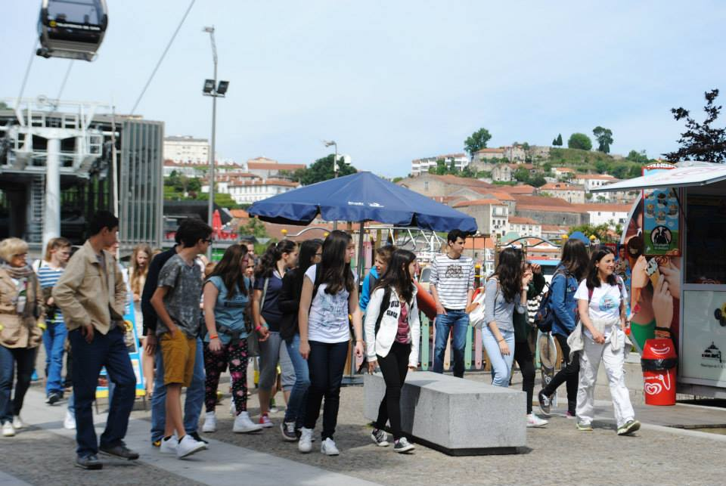
May 7th
3rd Day
On Wednesday we all went to Porto, the second-largest city in Portugal.

Slide 9
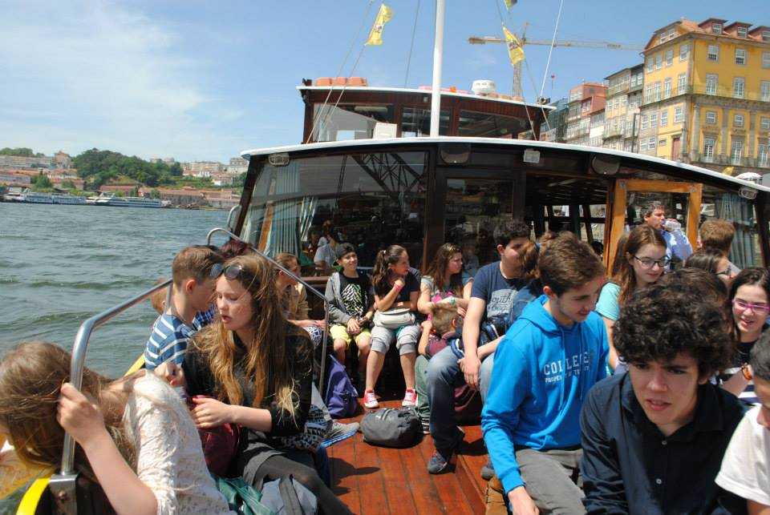
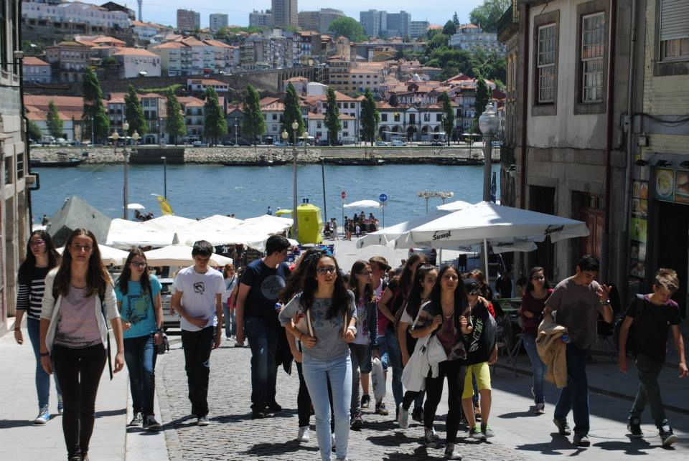
Boat trip on the Douro river
And some sightseeing

Slide 10
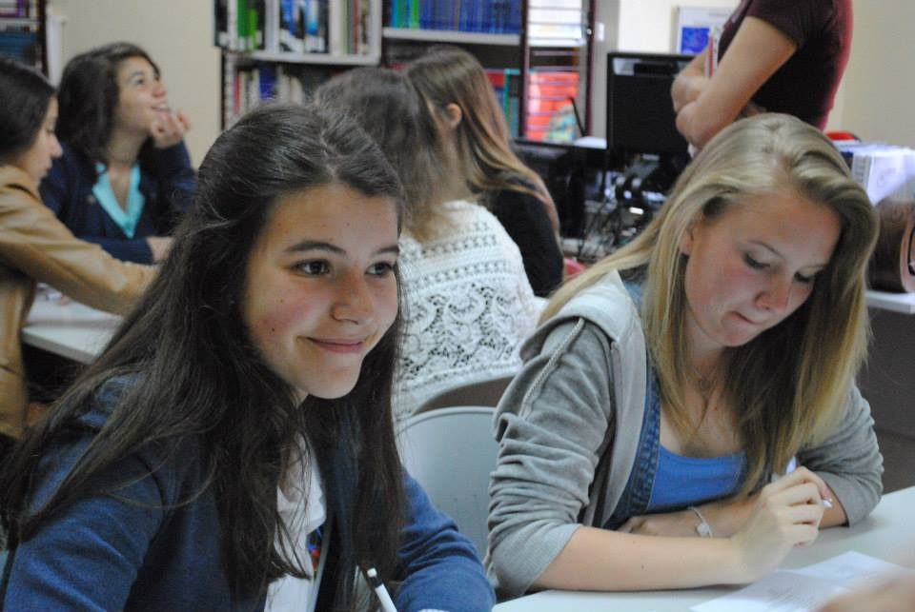
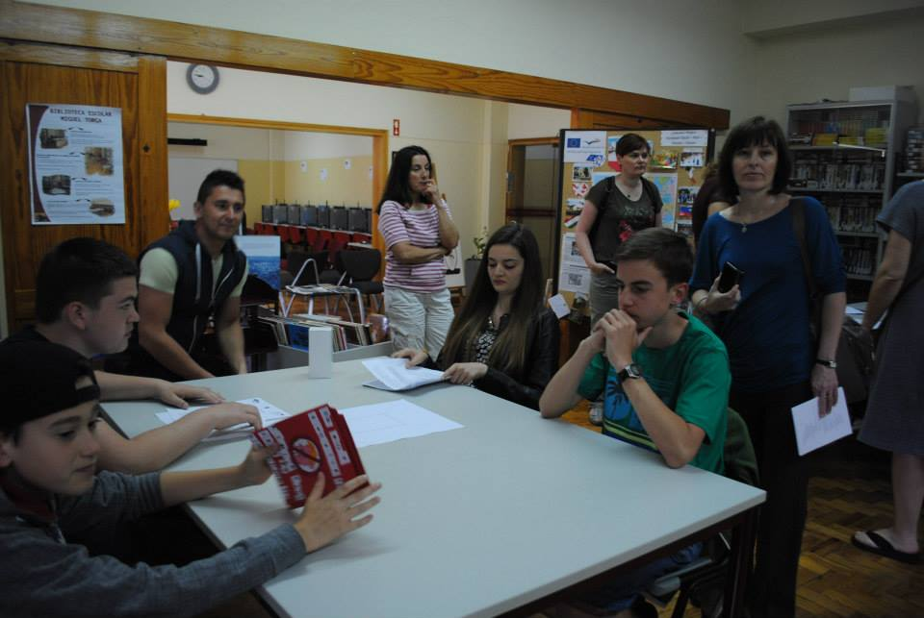
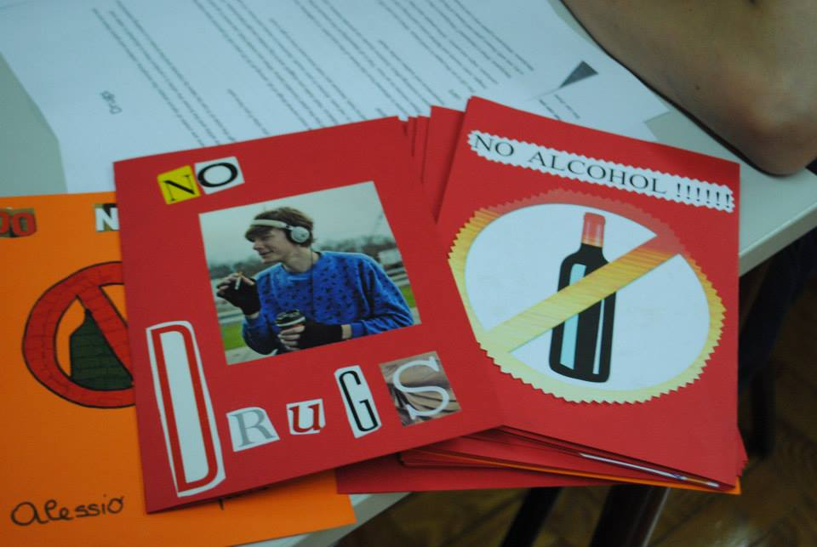
May 8th
4th Day
On Thursday we did our projects about the problems of teenagers.

Slide 11
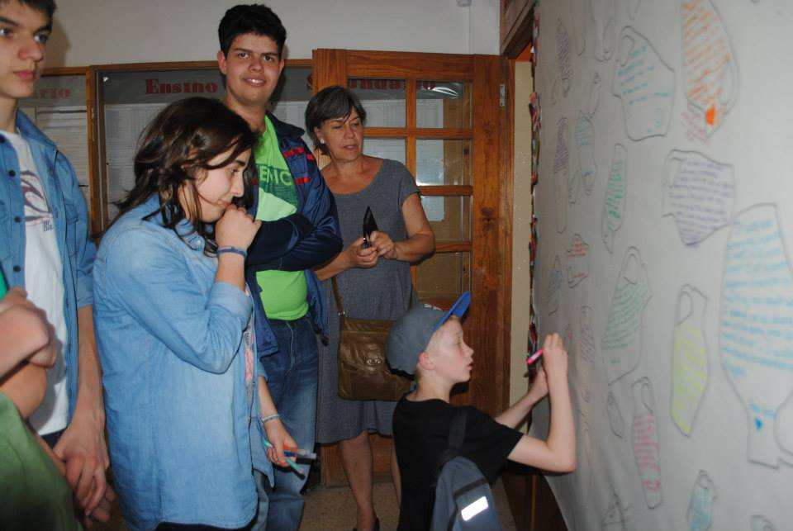
W could also leave a few words for our new friends from Portugal

Slide 12
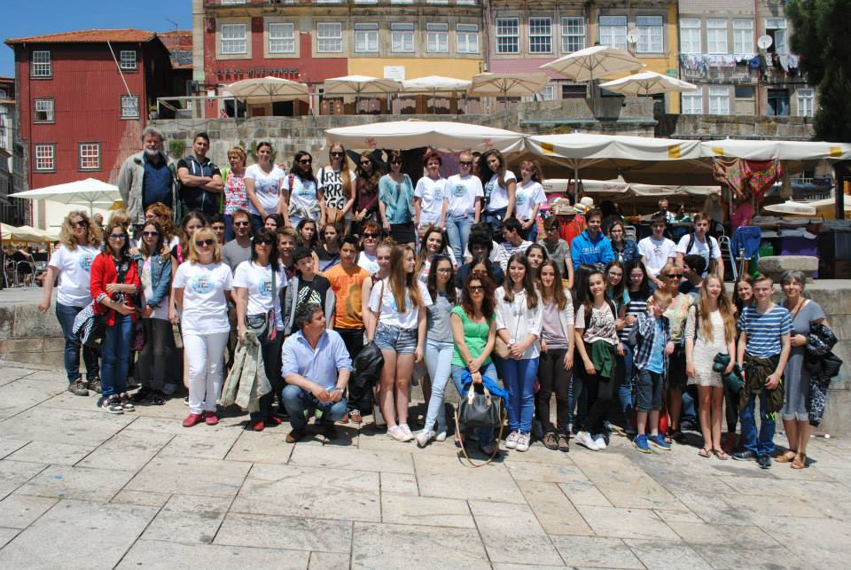
Unfortunately, that was the end of the meeting, but we are sure that we will never forget those days.

