Slide 1
German Day at Our School

Slide 2
Here is what the Student Council planned to do:
German Language Survival Kit
Quiz about Germany
The colours of the German flag in our clothes-a school competition
A special edition of the school newspaper

Slide 3
Germany- questions for the quiz
1. Geographical situation
2. The flag
3. What is the capital famous for?
4. Population
5. Currency
6. Main rivers
7. Famous Germans(scientists, musicians, writers, sportsmen)
8. The newest history
9. German cuisine
10. Things worth seeing in Germany ...
11... and why they are famous

Slide 4
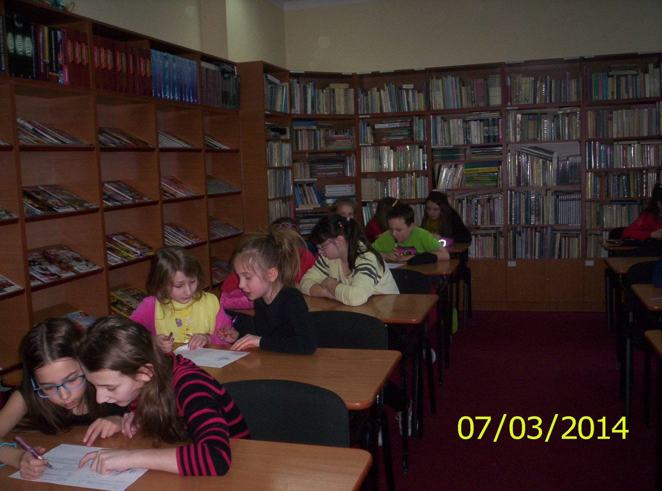
Quiz at the Primary School

Slide 5
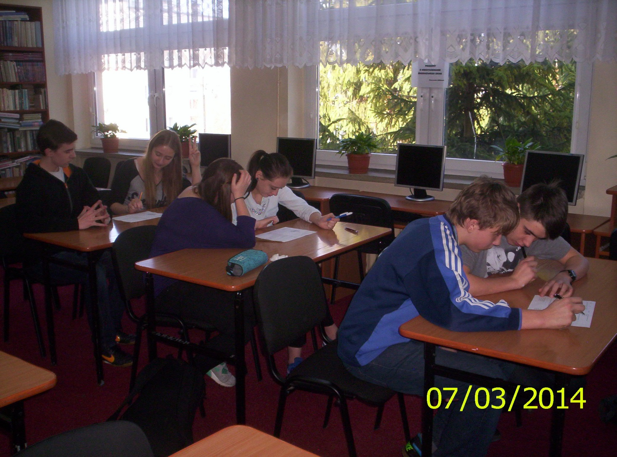
Quiz in our high school

Slide 6
Language Survival Kit
Dzień dobry – Guten Morgen, Guten Tag
Do widzenia – Auf Wiedersehen
Proszę - Bitte
Dziękuję – Danke
Przepraszam – Entschuldigung
Cześć - Hallo ☺
Cześć na pożegnanie – Tschüs!
Jestem z Polski – Ich komme aus Polen
Jak się masz?- Wie geht es dir?
Gdzie mieszkasz? – Wo wohnst du?
Mieszkam w Gdyni – Ich wohne in Gdynia
Jak masz na imię? – Wie heiβt du?
Nazywam się … – Ich heiβe …
Ile masz lat? – Wie alt bist du?

Slide 7
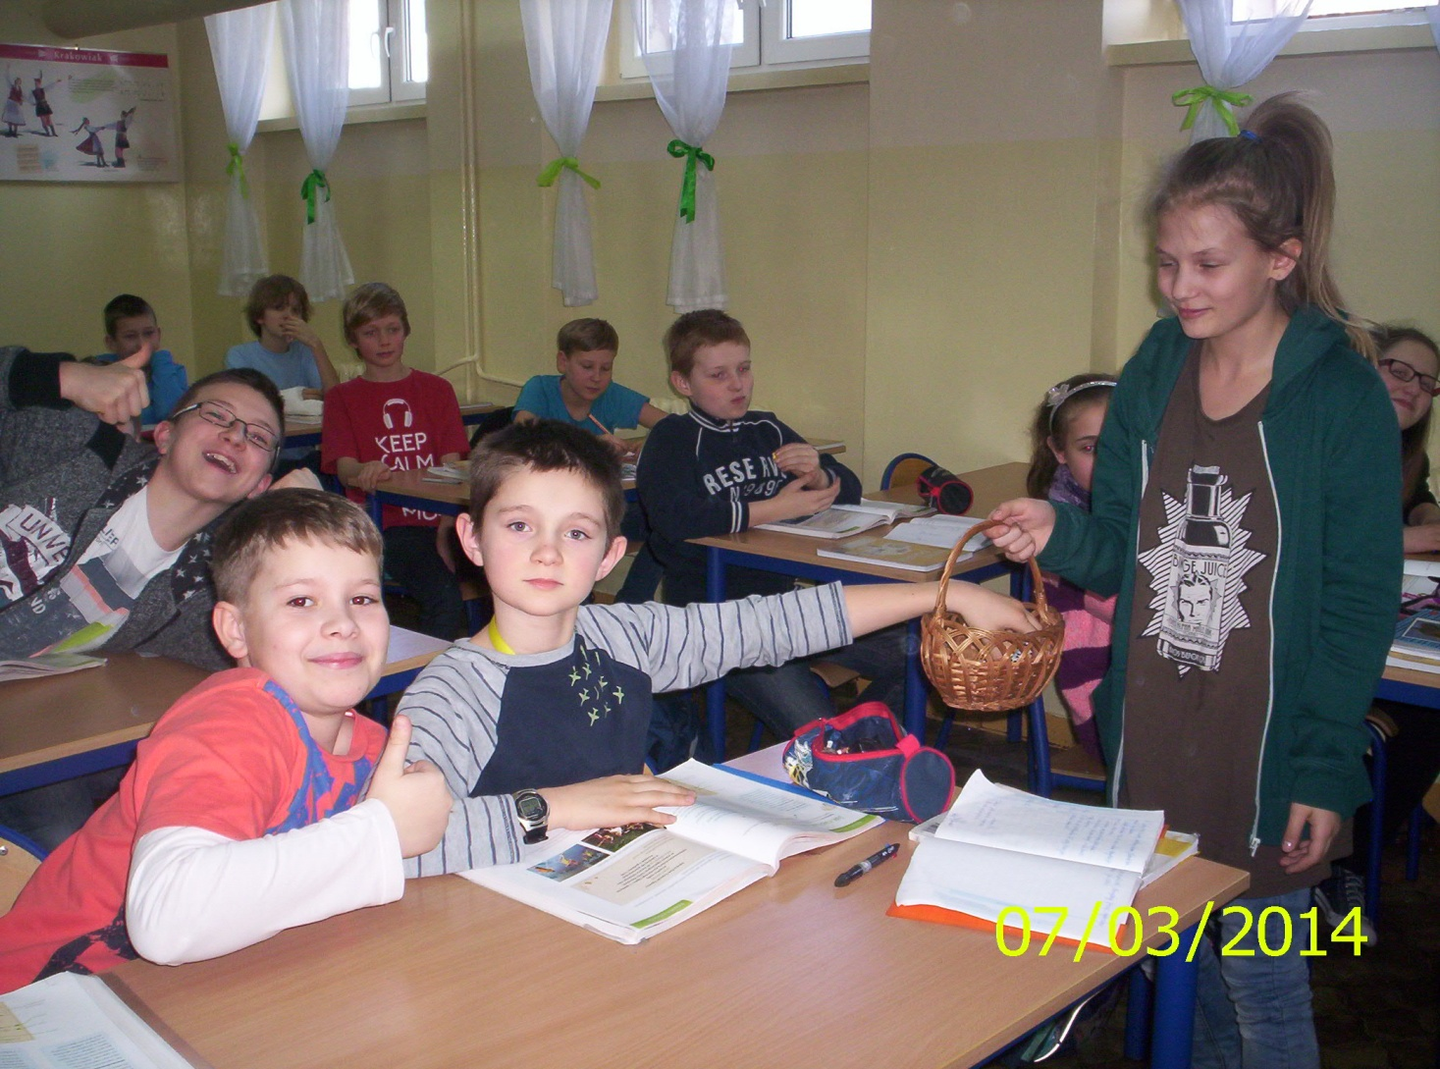
How good are our students at speaking German?

Slide 8
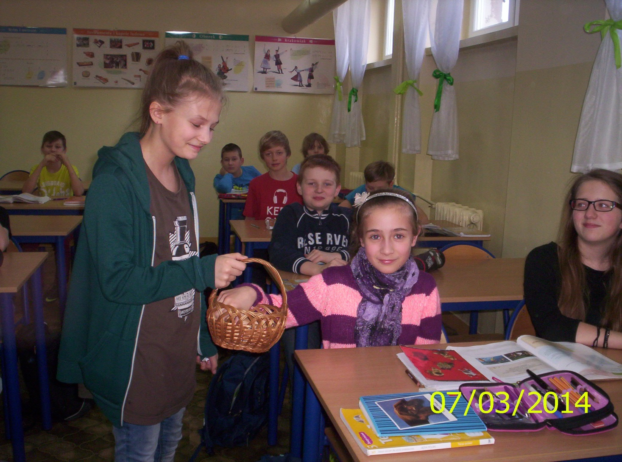
Surprisingly, the fourth grade students were the best at speaking German and very proud to know how!

Slide 9
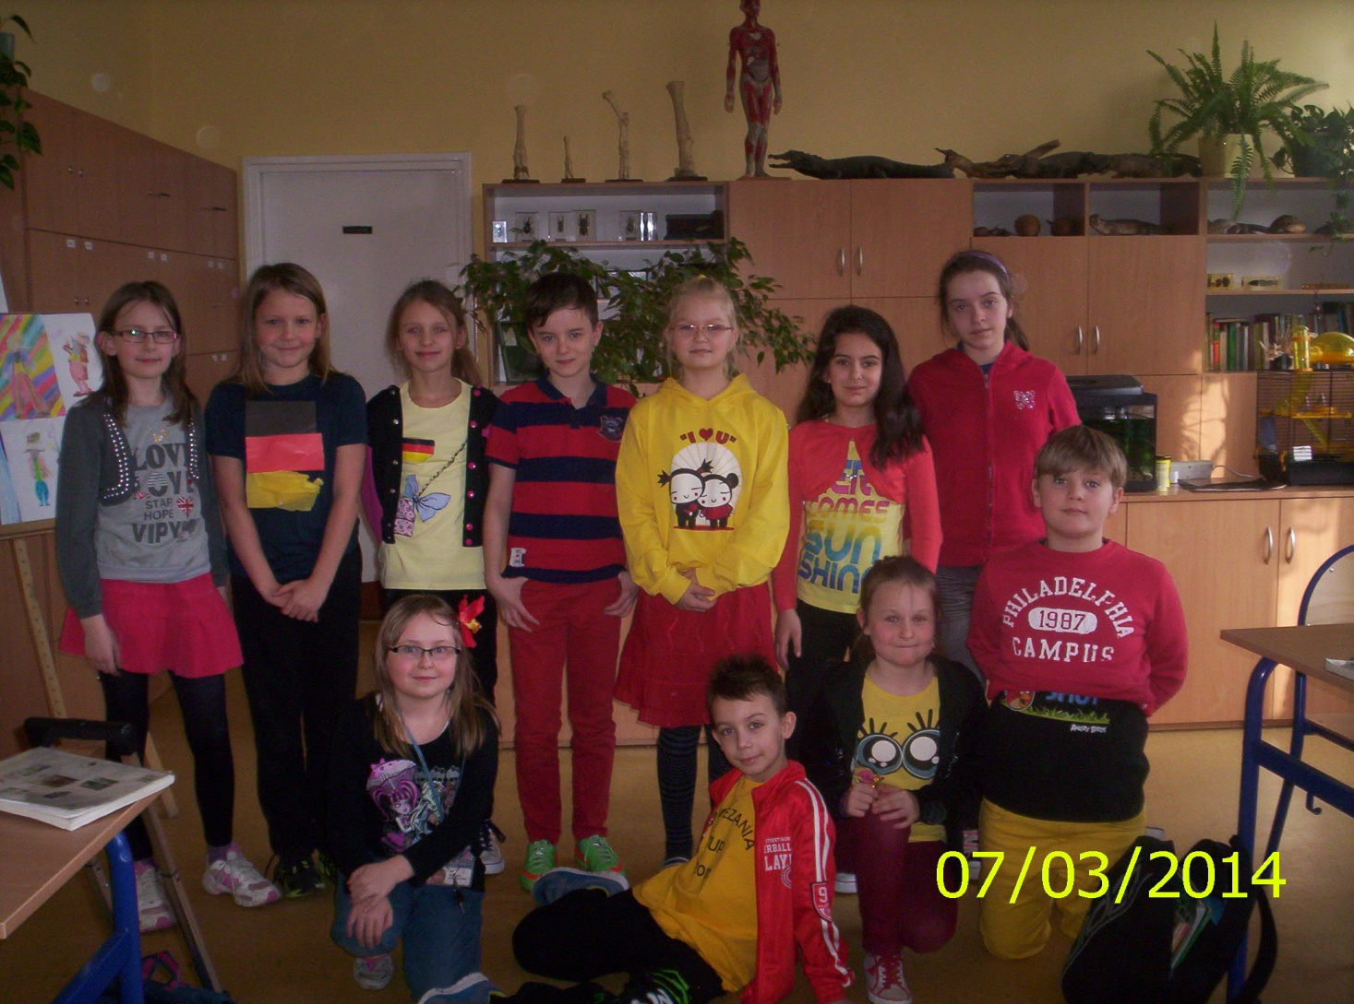
School Contest– German national colours in our clothes

Slide 10
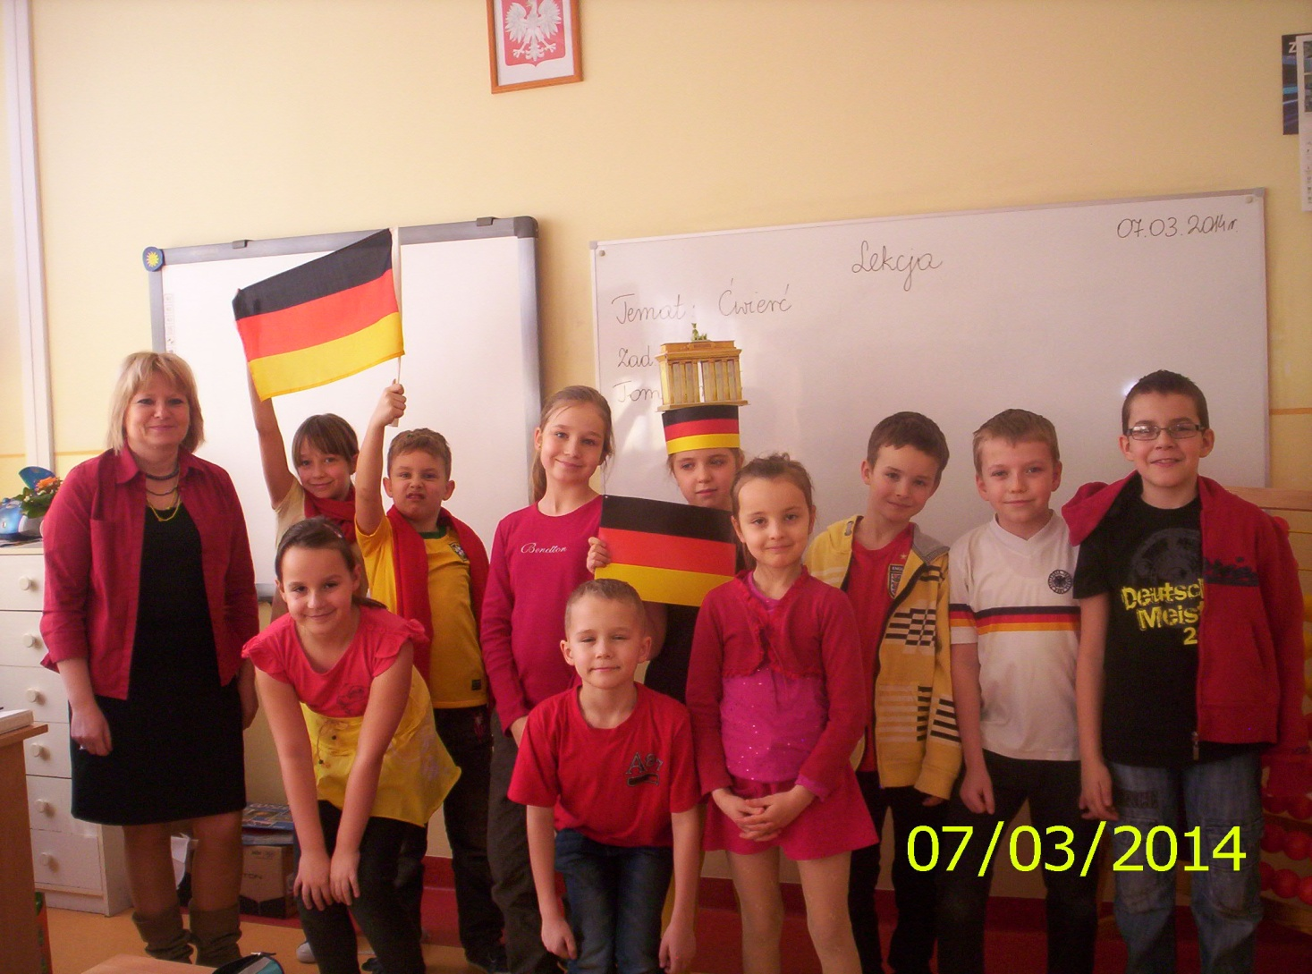
The winners I-III Primary School– class 3 b

Slide 11
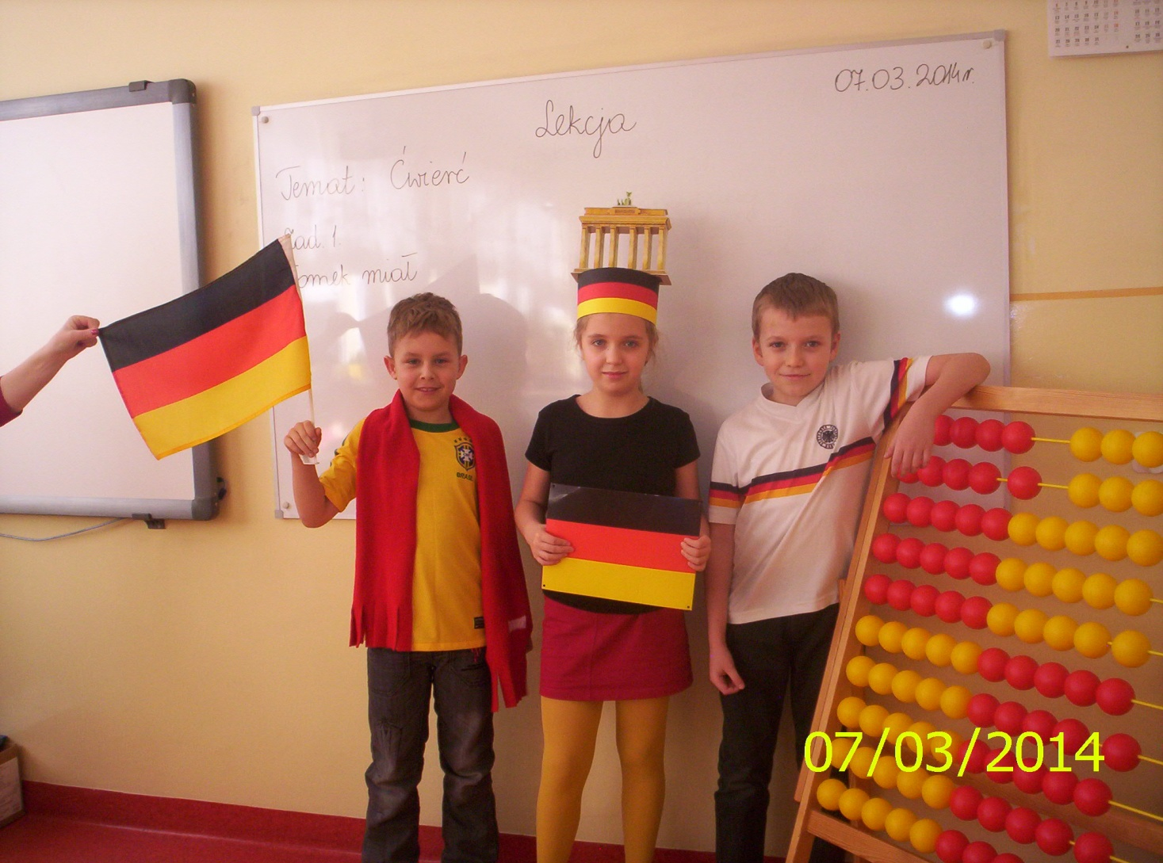
Zuzia, as always, in an original hat– this time the Brandenburg Gate

Slide 12
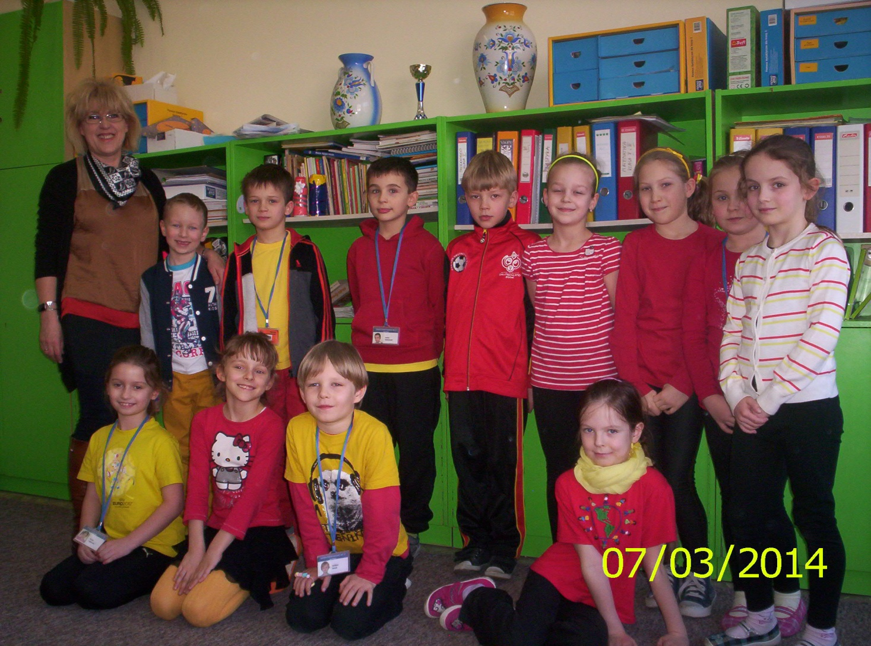
Class 1c

Slide 13
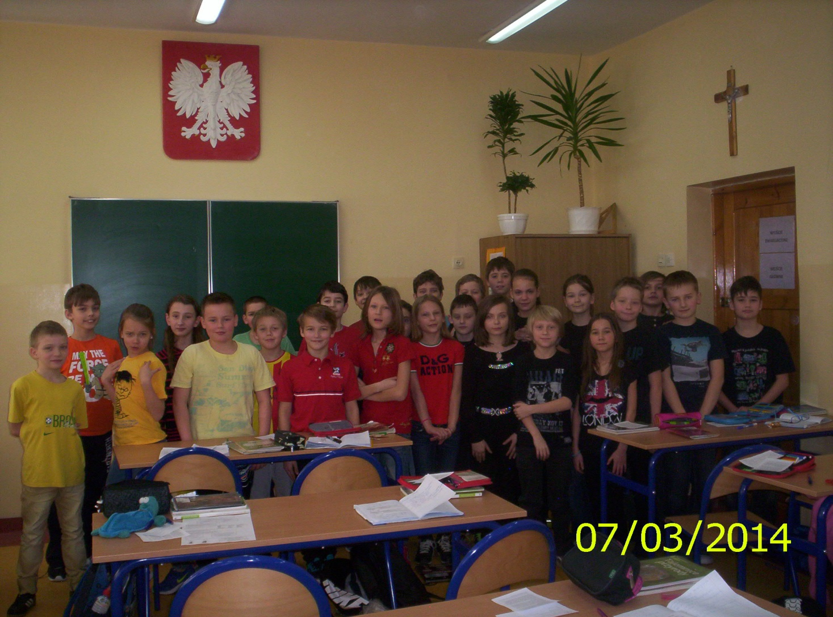
The winners IV-VI Primary School– class 4d

Slide 14
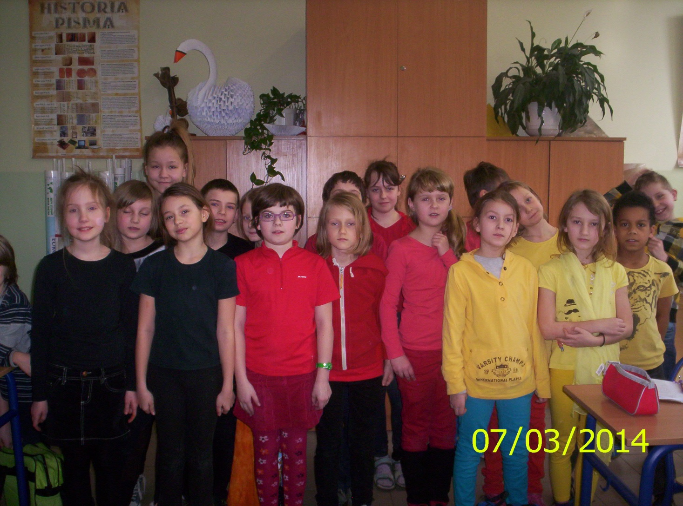
And class 4c

Slide 15
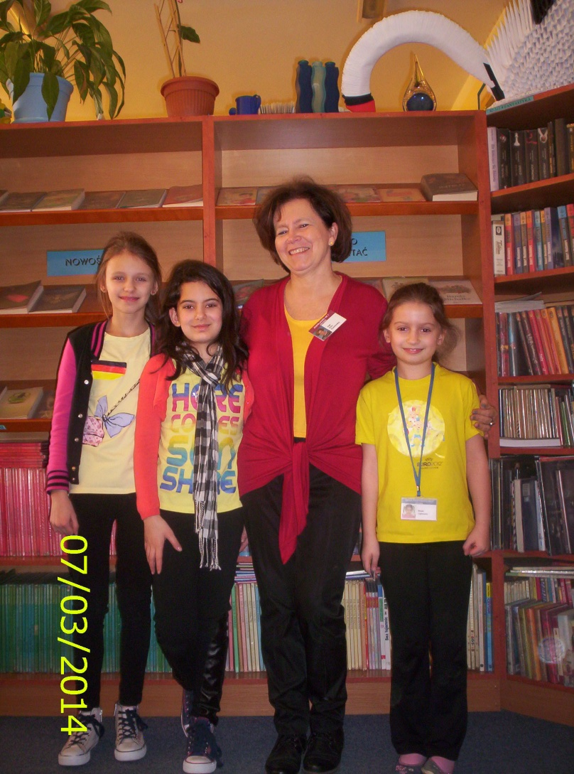
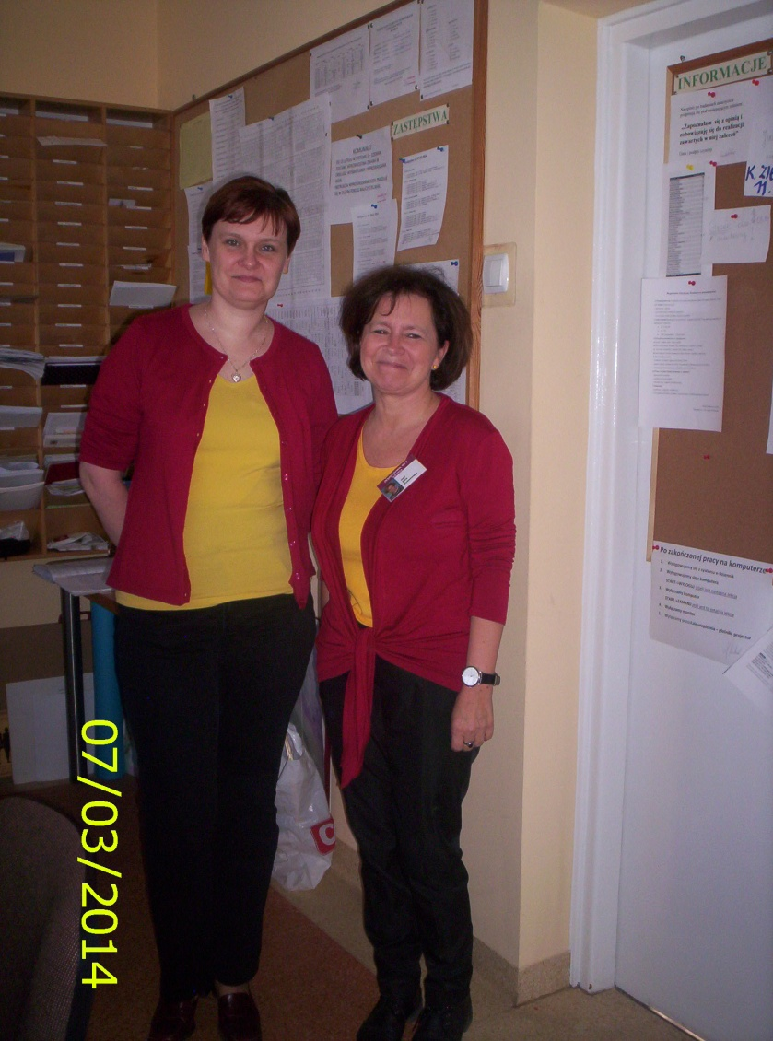
Both our teachers were perfectly dressed as well

Slide 16
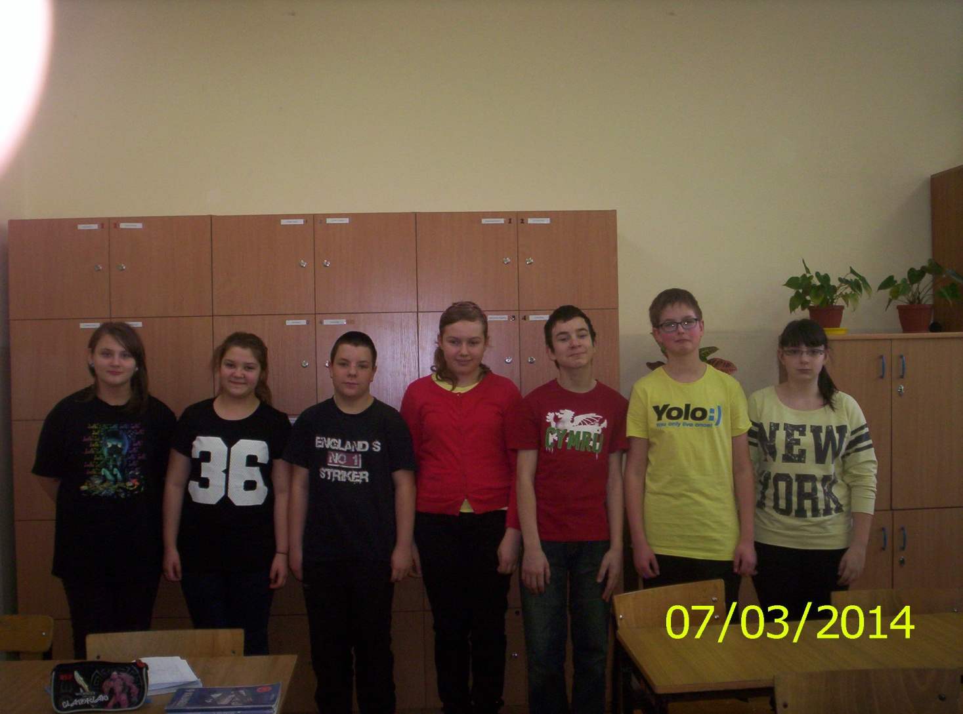
Class 6a

Slide 17
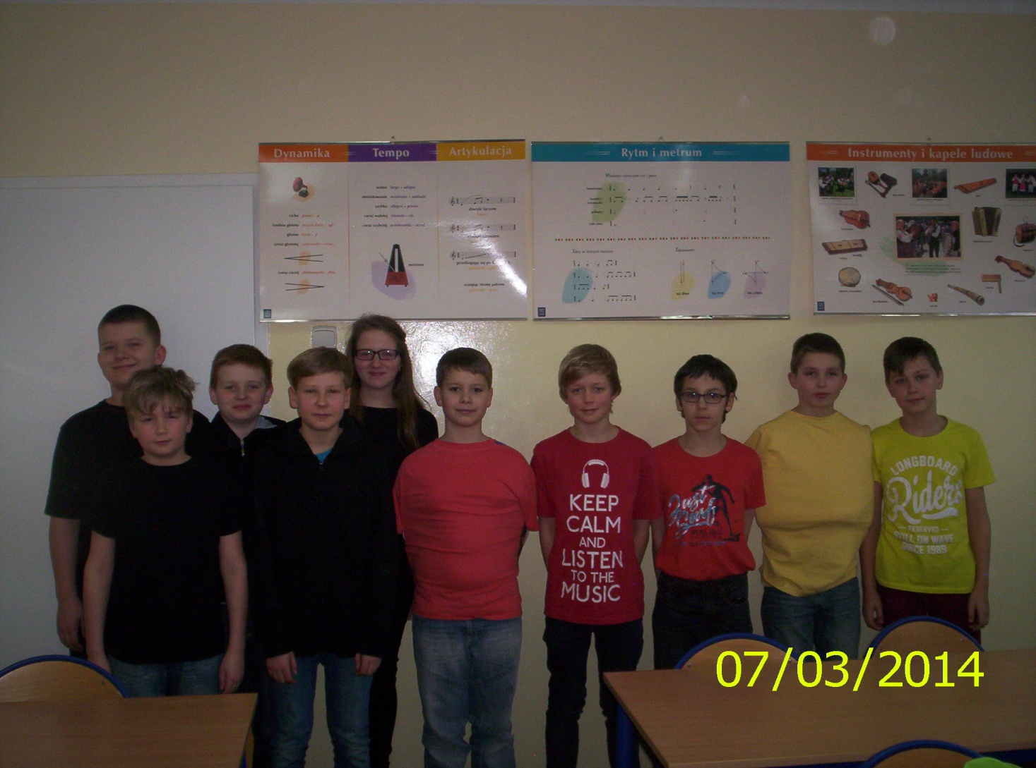
Class 5c

Slide 18
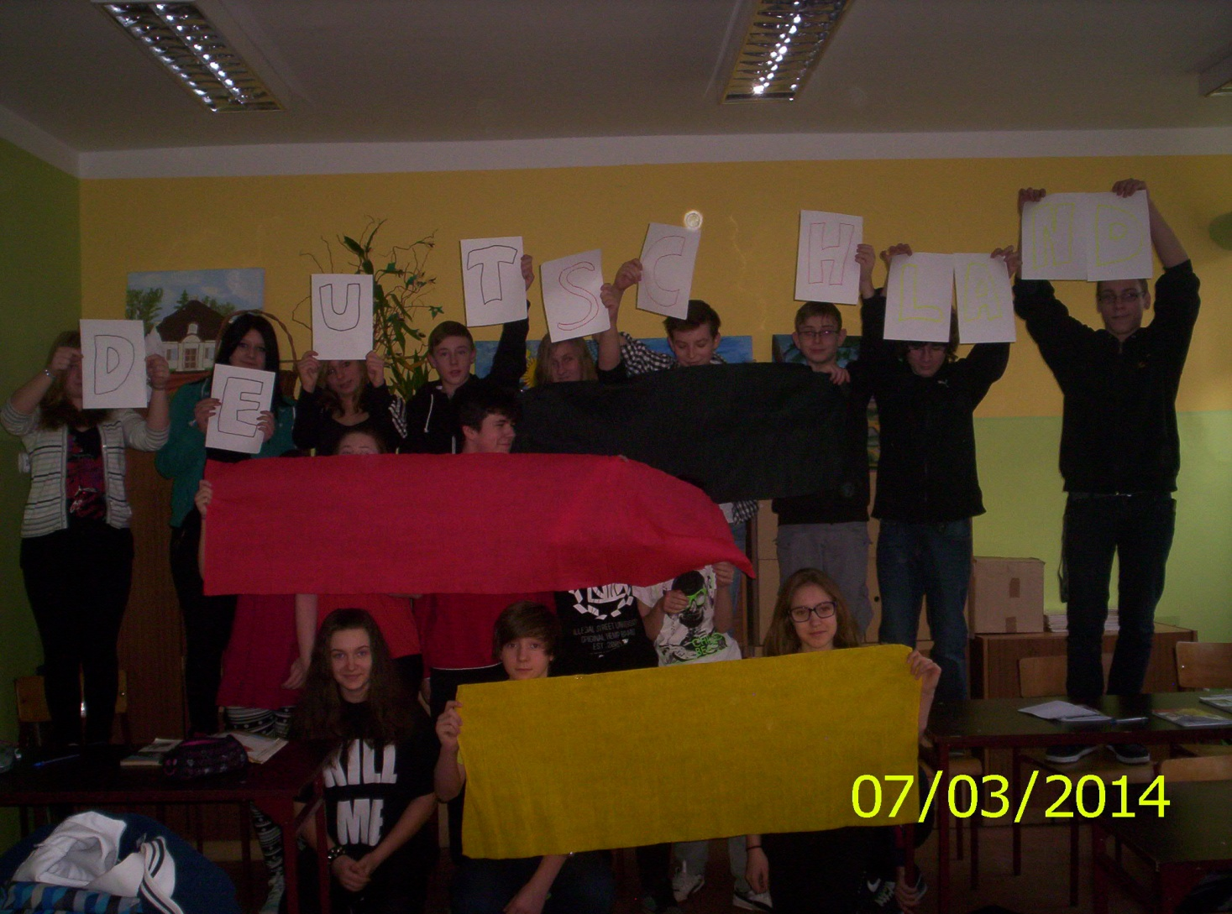
And – Ic from High School

Slide 19
danke schön ☺

