Slide 1

Portuguese Day at our school

Slide 2
Here is what the Student Council planned to do:
Portuguese Language Survival Kit
Quiz about Portugal
The colours of the Portuguese flag in our clothes-a school competition

Slide 3
Portugal- questions for the quiz
1. Geographical situation
2. The flag
3. What is the capital famous for?
4. Population
5. Currency
6. Main islands
7. Main cities
8. Portugal and geographical disoveries
9. Poruguses cuisine
10. What is worth seeing in Portugal?

Slide 4
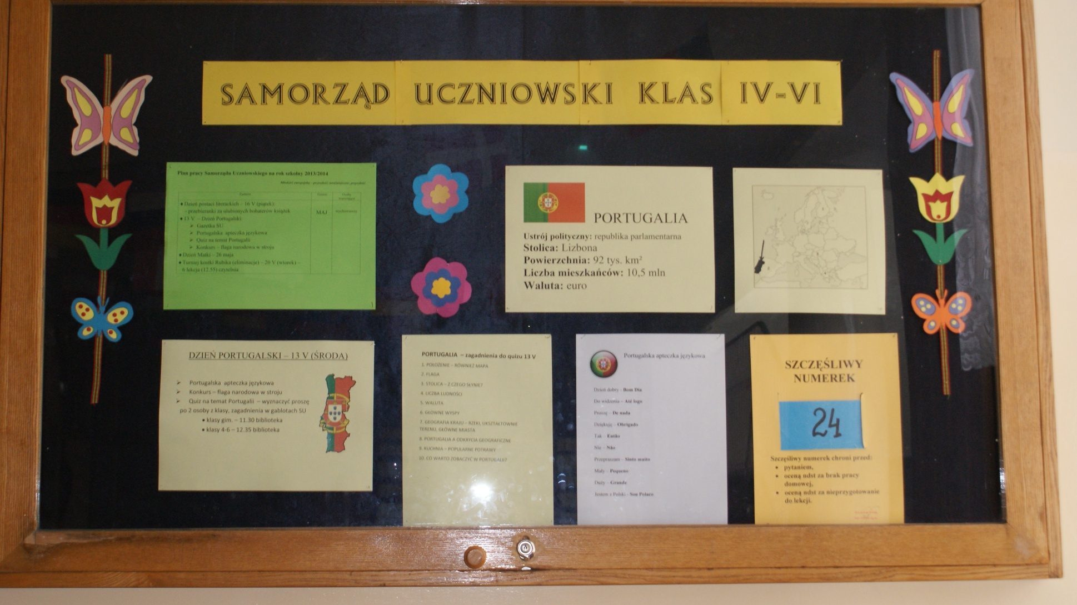
The students’ council board

Slide 5
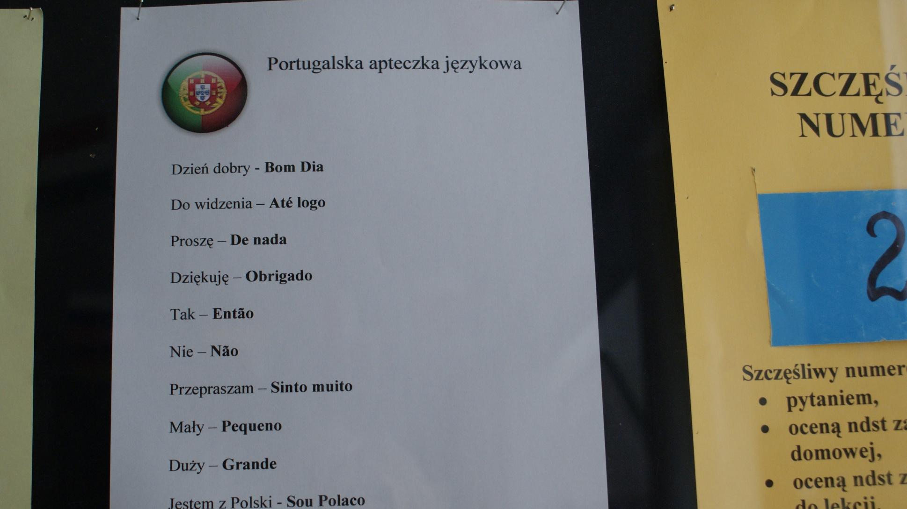
Portuguese Language Survival Kit

Slide 6
Portuguese Language Survival Kit
Dzień dobry - Bom Dia
Do widzenia – Até logo
Proszę – De nada
Dziękuję – Obrigado
Tak – Então
Nie – Não
Przepraszam – Sinto muito
Mały – Pequeno
Duży – Grande
Jestem z Polski - Sou Polaco

Slide 7
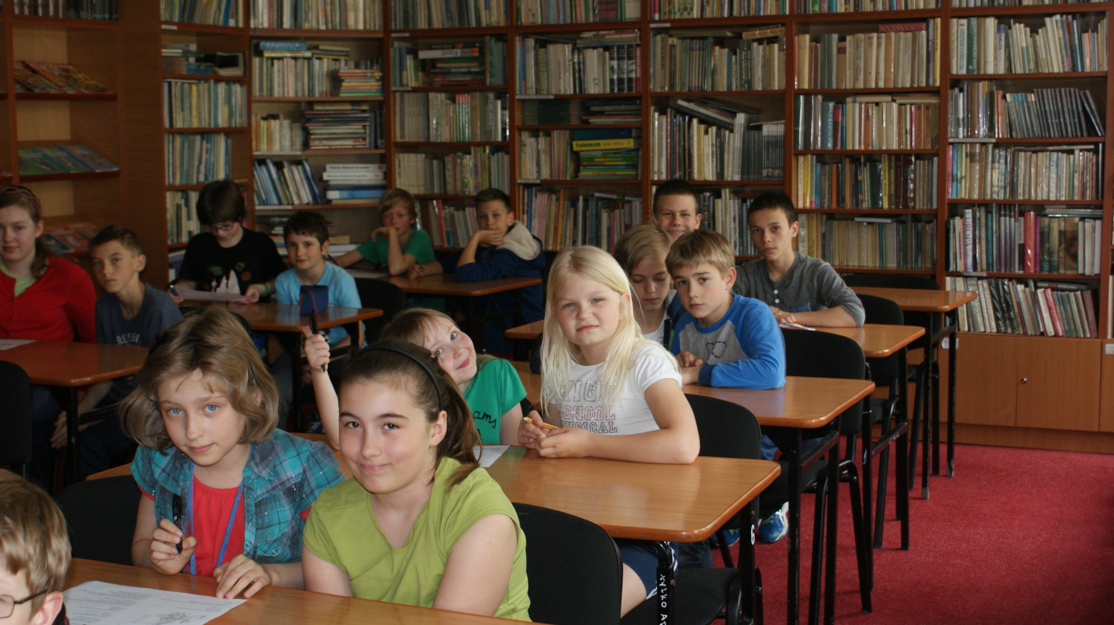
Quiz about Portugal in Primary School

Slide 8
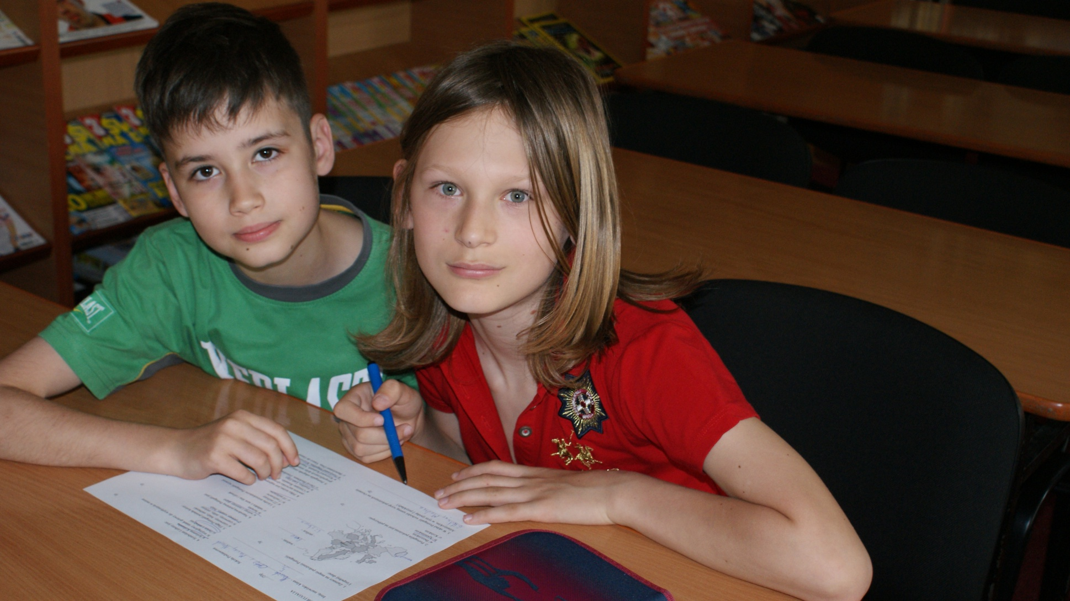
4c

Slide 9
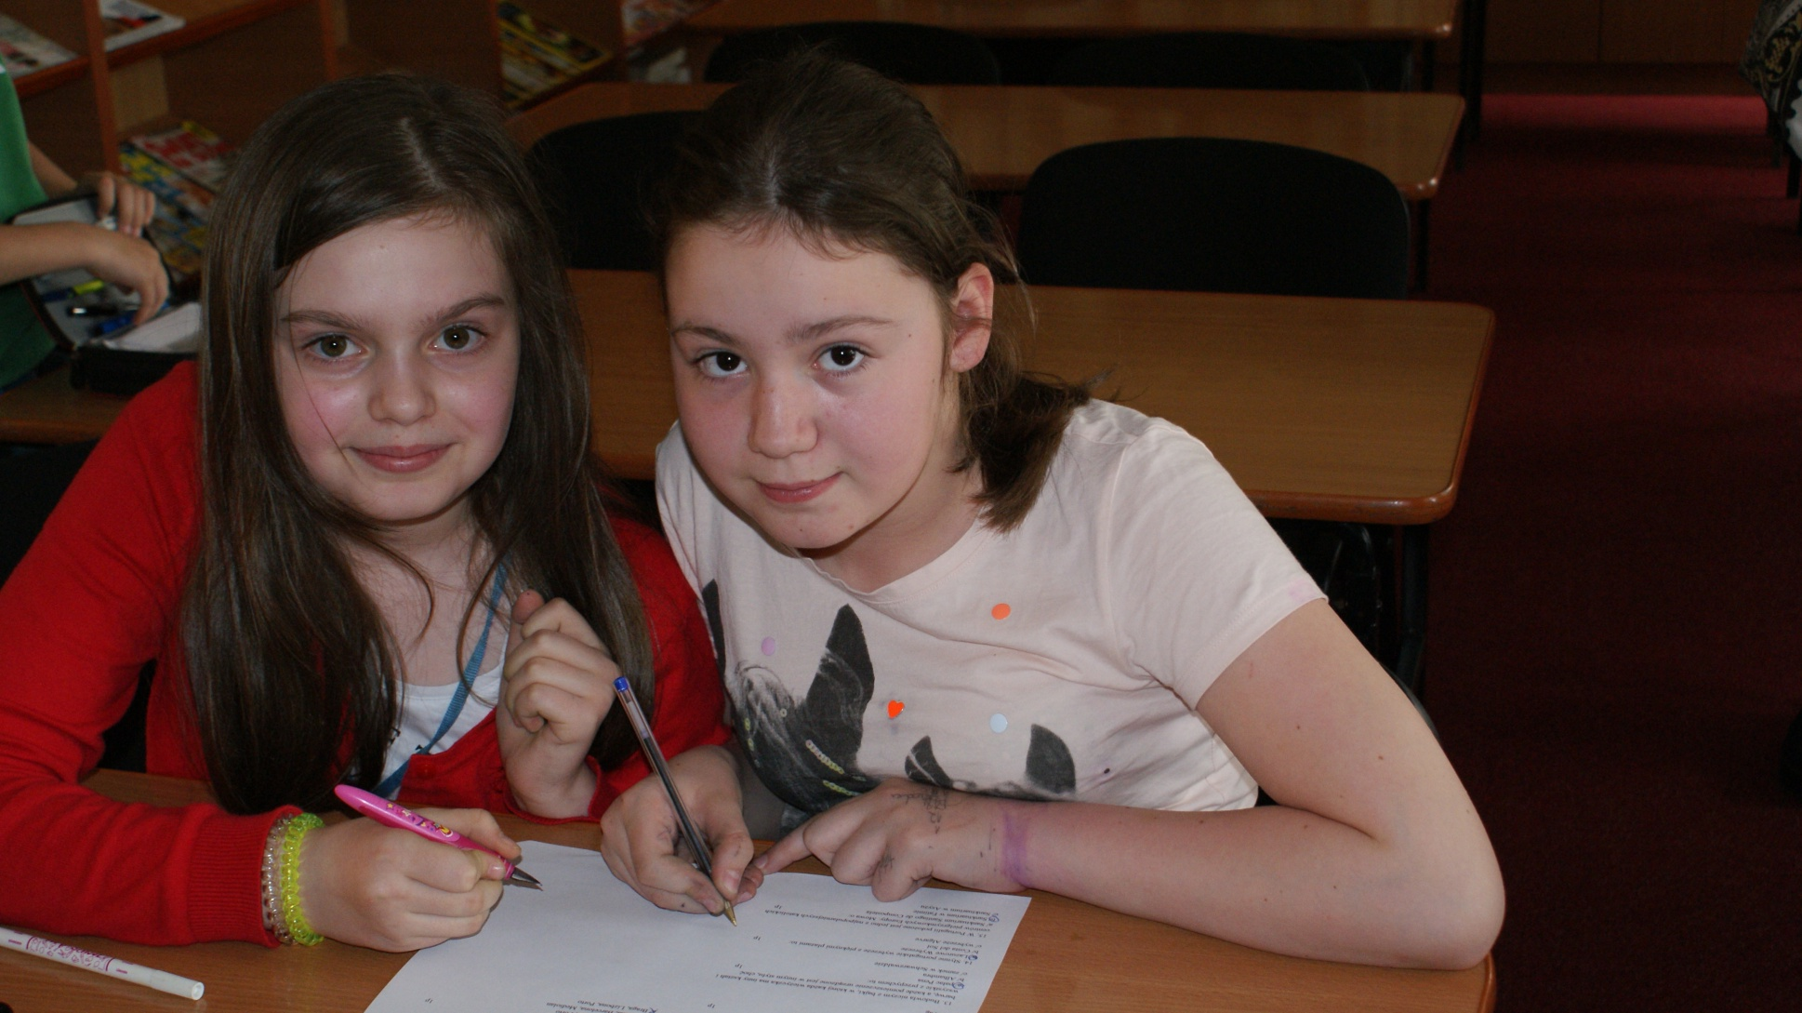
5a

Slide 10
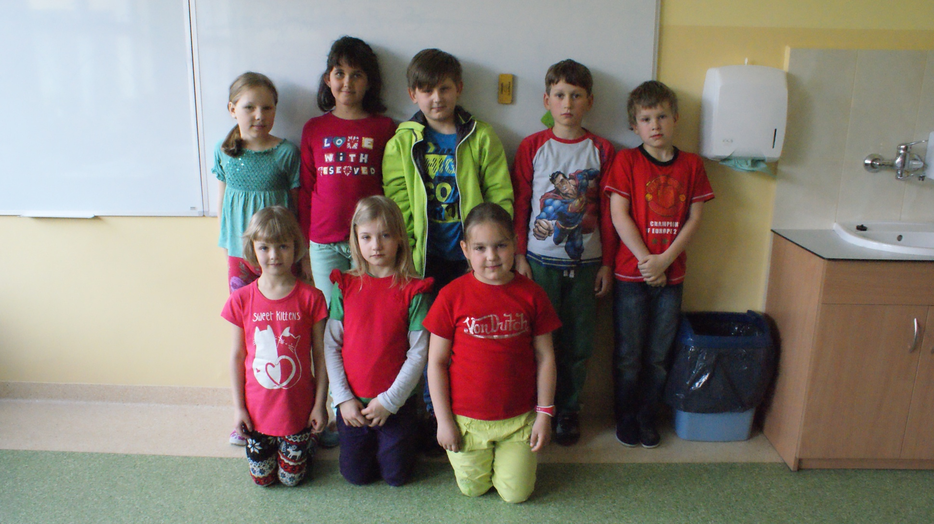
School Contest– Portuguese national colours in our clothes

Slide 11
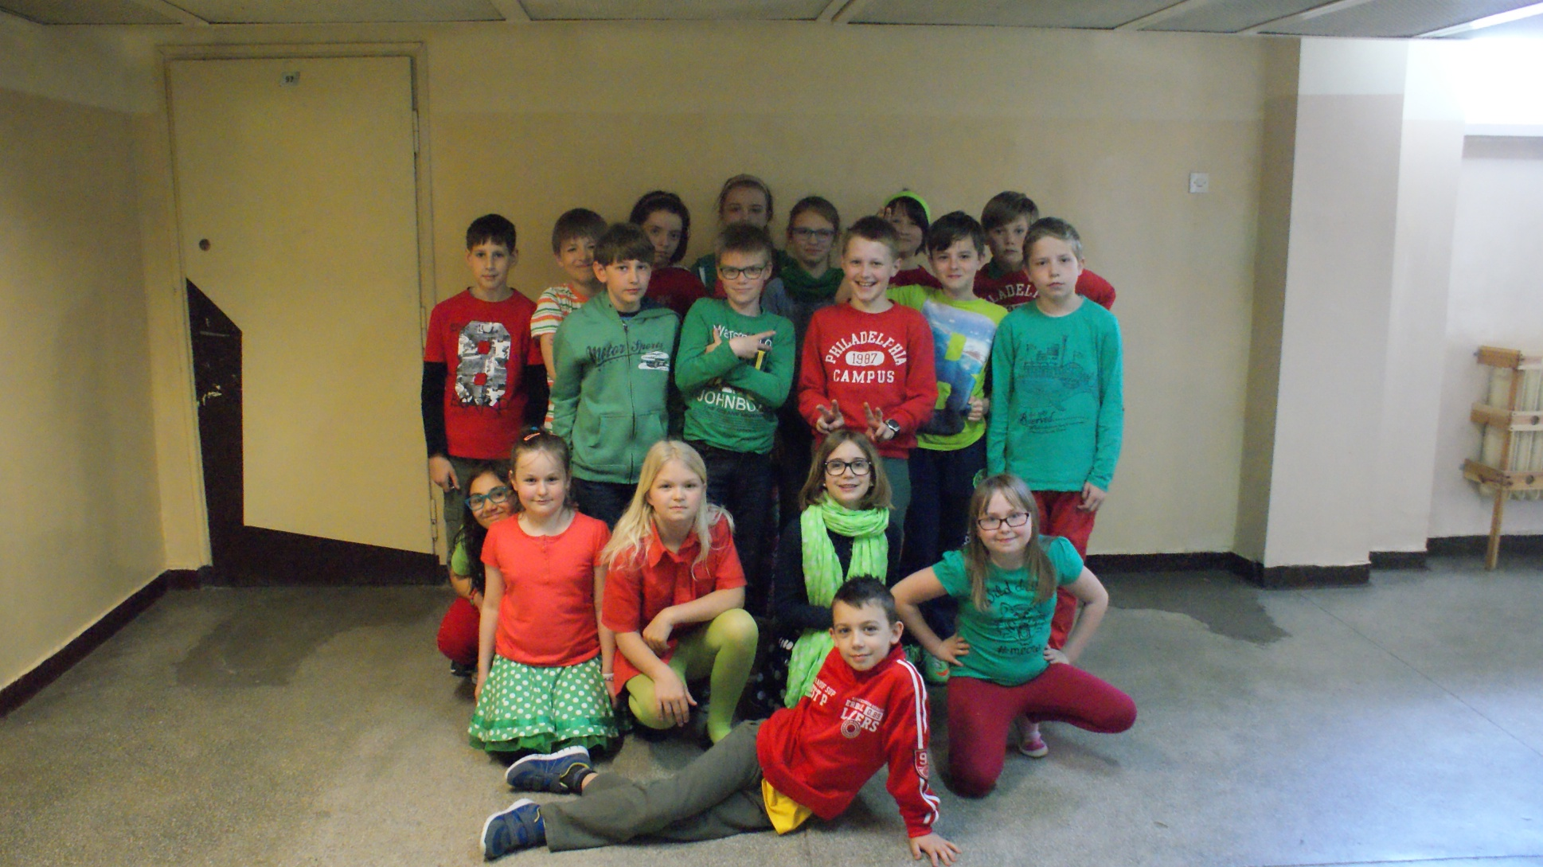
The winners – 4b

Slide 12
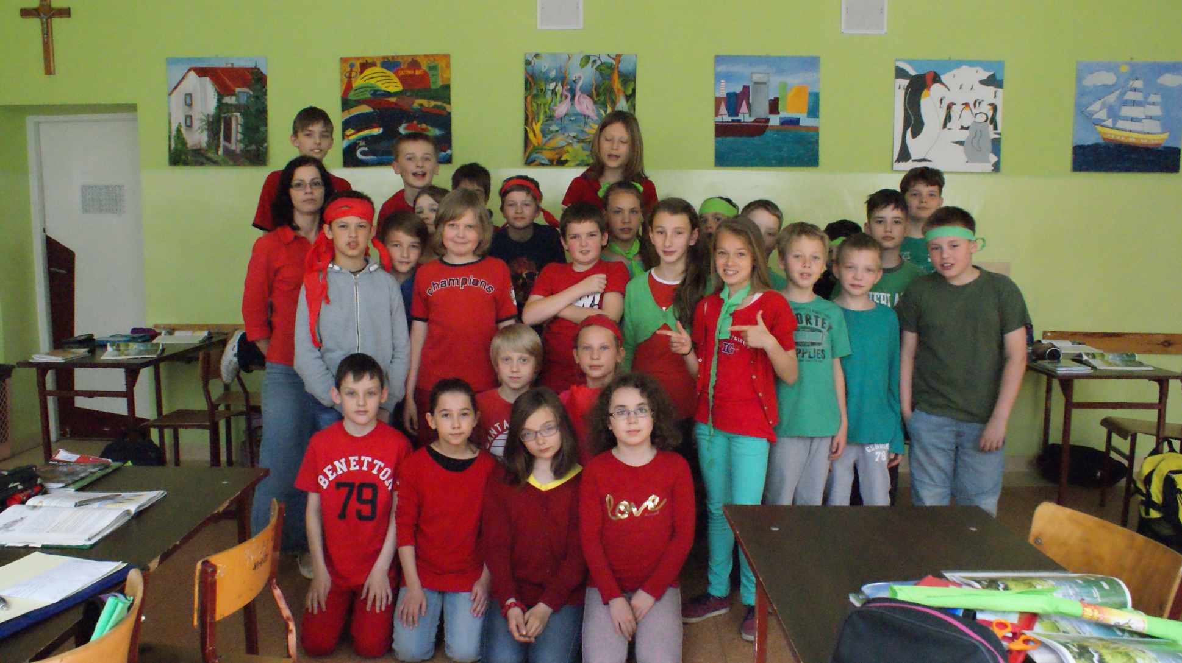
The winners– 4d

Slide 13
Obrigado ☺
Thank you for watching

